Slide 1
Stratifying ROSMAP patients with archetype analysis
Annat Haber
Lab meeting
September 2020
/sdata/carter-lab/carter/AMPAD/ampad_archetypes/
Notes:
A method for studying heterogeneity in multidimensional spaces, developed originally in the context of engineering and economics, and was recently adopted by Uri Alon and his lab from Weizmann Inst to study biological systems, especially gene expression data.

Slide 2
Problem: identifying types in a multidimensional space
Complex systems need to perform multiple tasks (by definition)
No system can be simultaneously optimized for all tasks, leading to trade-offs.
Korem et al 2015
Notes:
The basic problem we’re trying to address here is to characterize the heterogeneity and identify subtypes in a multidimensional space. This is usually approached with something like PCA or k-means clustering etc. These methods approach the problem from a purely mathematical perspective of decomposing the variance in the system regardless of what’s underlying the variation.
The archetype analysis on the other hand, approaches it from the perspective of a complex functional system, starting with two fundamental observations: complex systems need to perform multiple tasks – by definition - and no system can be optimized for all tasks at all times, which necessarily leads to trade-offs, or compromises.
These trade-offs manifest themselves as different types in the multidimensional space.
When we think about it from the system’s perspective, we’re rephrasing the problem as finding those underlying tasks, which presumably should give us more biologically-relevant features.
So if we think about cell types in gene expression space, each ideal cell type would be optimized to perform a specific physiological task associated with a unique gene expression profile. But real cells need to perform many tasks, with inevitable trade-offs between those tasks, so they end up lying somewhere in between, and we can characterize each data point based on how close it is to either ones of these ideal types, or archetypes, which presumably reflects how well that phenotype can perform each of these tasks.

Slide 3
Complex systems need to perform multiple tasks
No system can be optimized for all tasks at the same time, leading to trade-offs.
Solution: apply selection theory to predict number and position of archetypes
Performance decreases with distance from each archetypes
Phenotypes off the front underperform and are therefore eliminated
Pareto front
Sheftel et al. 2013
Notes:
So how do we find those types in a real situation? Phrasing it in terms of tasks and trade-offs allows us to apply selection theory and the fitness function, that are inherently all about optimizing trade-offs.
The most basic assumption here is that performance is decreasing with distance from each archetypes, therefore the best compromises necessarily lie on this straight line between the two archetypes. Any phenotype that lies off that line is by definition underperforming and therefore eliminated. This line represents the Pareto front: it’s a graphical representation of all the best compromises between two archetypes. When we move along this front, we necessarily become better at one task and worse at the other task. When we move off that front we necessarily become worse at both tasks.
How could that be relevant for complex diseases? Patients are presumably not subject to natural selection like wild populations?? They don’t, but the pleiotropies and epistasis underlying their pathology are the result of natural selection. So for example, say we have a disease that involves both neuronal disfunction and increased inflammation, but for some weird pleiotropic reason people who have strong risk factors for both pathologies tend to die of heart attack at the age of 50 long before the have a chance to develop dementia, then we won’t see them in our sample of 90 yo Alzheimer’s patients. And so what we would see are patients that have either lots of neuronal disfunction and little inflammation or the other way around, but very few in between. This is actually more like sorting than direct selection, in the world of macroevolution, but that’s besides the point.
The simplest most pragmatic way to think about it is that, instead of looking for the averaged type like k-means clustering does, this method looks to identify the extremes in the data, the archetypes, which should provide a clearer idea for what distinguishes those types.

Slide 4
Assumptions:
For each task there is a single phenotype that maximizes performance for that task (the archetype)
The fitness of each phenotype (e.g., cell) is a linear combination of its ability to perform each of the tasks
Performance decays monotonically with distance from archetype
All performance functions decay with the same norm from their maxima
Predictions:
The Pareto Front of complex systems is a convex hull (polytope)
Archetypes are the vertices of the polytope
The effective dimensionality of the system is k – 1; where k is number of archetypes
No matter how many traits represent the underlying system, the emerging phenotypes will fall on a polytope within a low-dimensional space based on the number of tasks
Sheftel et al 2013
Notes:
These are the assumption in more details. In this paper Uri Alon’s group show with simulations that even when these assumptions are relaxed a bit the method is still useful in most cases.
These assumptions allow us to make the following predictions, and the bottom line is that no matter how many traits represent the system, the emerging phenotypes will fall on a polytope within a low-dimensional space based on the number of tasks.

Slide 5
Find number and position of archetypes of AD patients (ROSMAP cohort)
Extract “typical” gene expression profiles (== modules of DEG)
Compare with current (sub)modules
Map distance from archetypes onto WGS
Repeat for proteomics data and compare
Notes:
The workflow that I’ve been following here

Slide 6
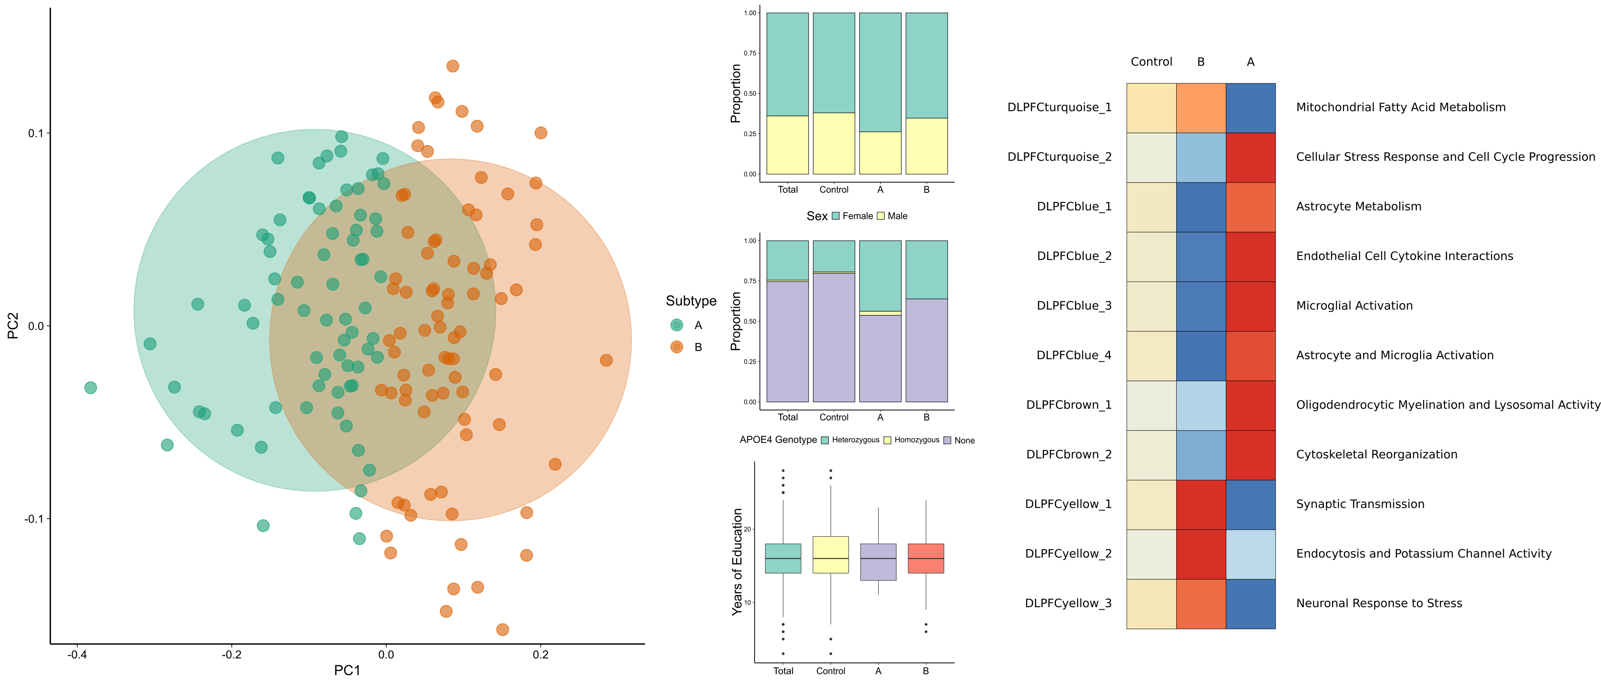
Notes:
A reminder - this is what Nikhil found in his study using k-means clustering:
two main subtypes:
subtype A that involves mostly inflammation, and subtype B that involves mostly neuronal function

Slide 7
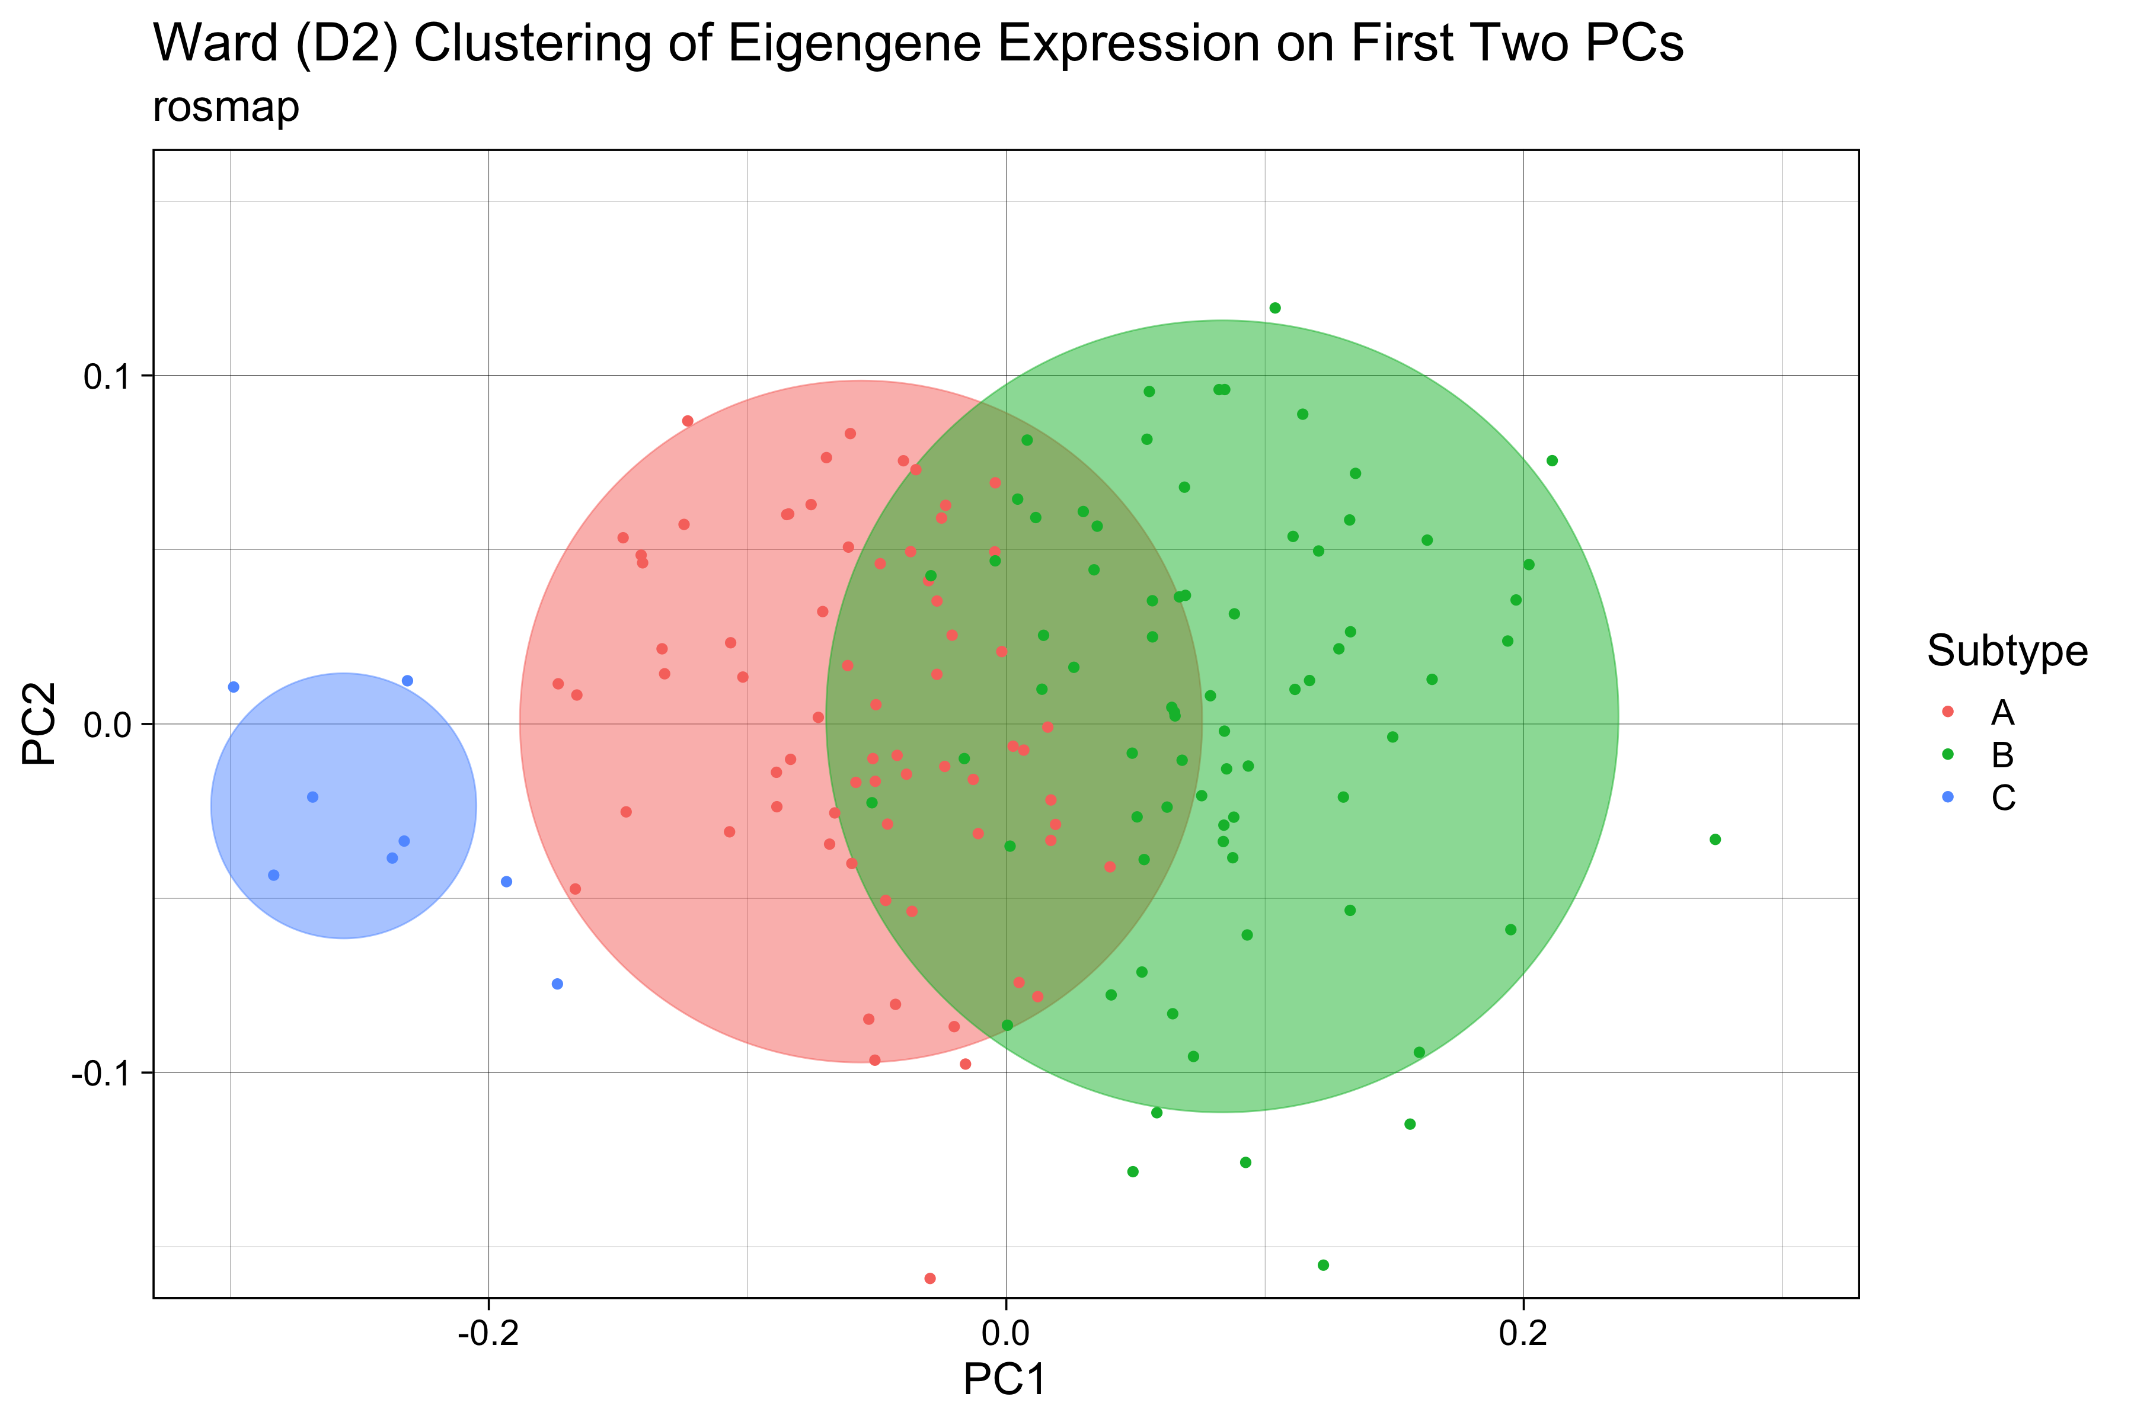
ROSMAP
(N=623)
Notes:
In the first round of Nikil’s study there were three subtypes found, 2 big ones and 1 small one, but the third one was too small, so it was dismissed. As I’ll show you in a second, using the archetype analysis we were able to recover that third subtype with a more even distribution of patients between the subtypes and a very distinct gene expression profile for each of them.

Slide 8
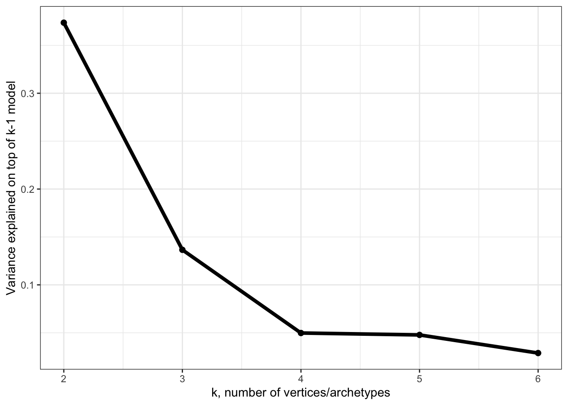
3 archetypes explain >50%
4th archetype adds < 5%
Notes:
The first step is to find the optimal number of archetypes by fitting polytopes with a different number of vertices and looking at how much variance each polytope explains.
So a straight line with 2 archetypes explains less than 20% of the variance, but 3 archetypes – a triangle – already explain a little over 50%. Of course, the higher the number of archetypes the more variance explained, but it’s important to look also at how much more variance is explained with additional complexity. Adding a forth archetype only adds less than 5% to the explained variance.
Other studies also found 3 subtypes for AD (rosmap cohort and others)
https://www.alzforum.org/news/conference-coverage/proteomics-uncovers-potential-markers-subtypes-alzheimers
The original papers and R package mostly uses Principal Convex Hull algorithm to fit the polytopes. But other methods are incorporated into Alon et al’s matlab package

Slide 9
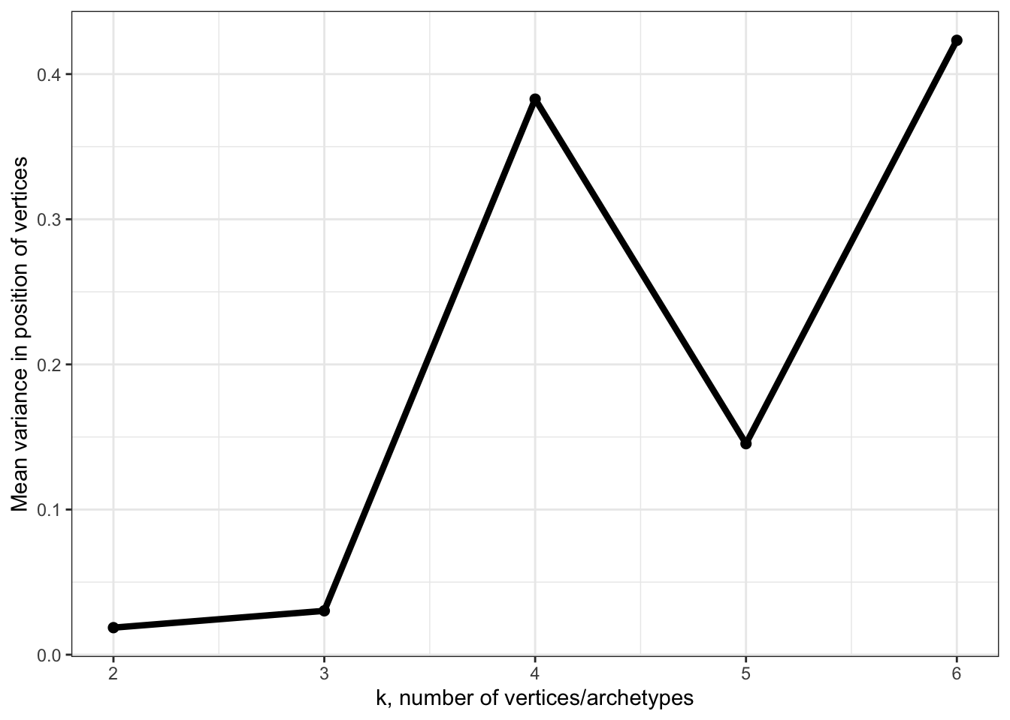
3 archetypes explain >50%
4th archetype increases uncertainty 10x
3 archetypes
Notes:
Also, adding a 4th archetype increases the average variance around each archetype 10x. So looks like the optimal number of archetypes for this space is 3.
Other studies also found 3 subtypes for AD (rosmap cohort and others)
https://www.alzforum.org/news/conference-coverage/proteomics-uncovers-potential-markers-subtypes-alzheimers
The original papers and R package mostly uses Principal Convex Hull algorithm to fit the polytopes. But other methods are incorporated into Alon et al’s matlab package

Slide 10
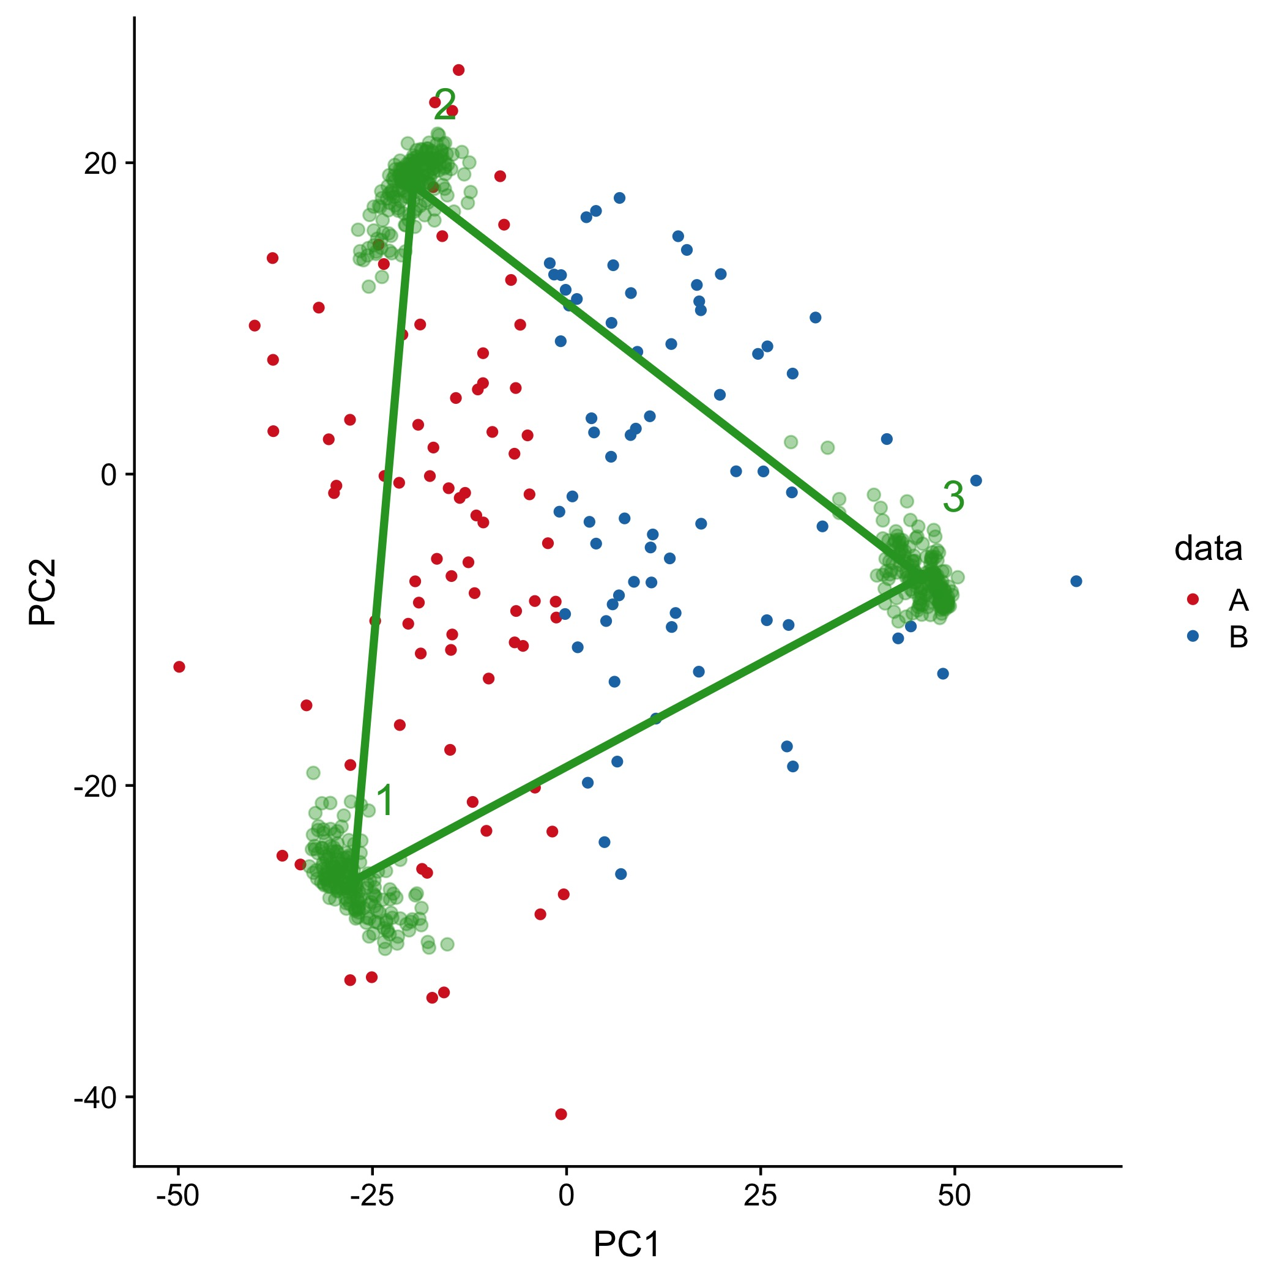
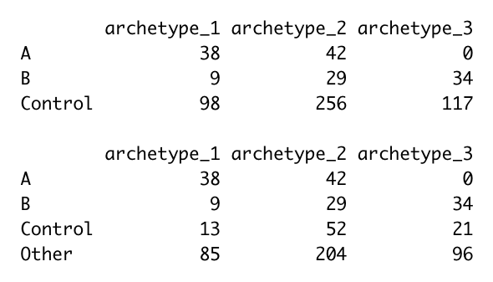
Position of archetypes in GE space relative to Nikil’s K-means subtypes
Archetype 3 is all subtype B
Archetype 1 is mostly subtype A
Archetype 2 is a mix
Control and MCI are all over
B
A
No enrichment for cognitive/braak/cerad scores or apoe4 status
Archetype 2 is slightly enriched for female AD
bootstrap
Notes:
This is how the archetypes compare with Nikil’s subtypes
The green dots are archetype position in bootstrapped samples so that gives us an estimate of the potential error around the inferred position of each archetype
Blue dots are subtype B from Nikhil’s work, red is subtype A.
Archetype 3 is pretty much all subtype B, 1 is mostly subtype A and 2 is a mix.

Slide 11
Top genes breakdown:
Genes whose expression decreases significantly as a function of distance from an archetype
Archetype 1: 626 genes
Archetype 2: 551 genes
Archetype 3: 1538 genes
Overlap between archetype 1 and 2: 8 genes
Overlap between archetype 2 and 3: 1 gene
Overlap between archetype 3 and 1: None
Notes:
The next step is to find the genes whose expression is associated with each archetype, and to do that we look for genes whose expression decreases consistently in individuals that are further away from the archetype.
Out of the ~15000 genes in the original dataset, I found a total of ~2700 genes significantly associated with at least one of the archetypes, with practically no overlap between them, so we can really think of these sets of genes as modules that differentiate between archetypes.

Slide 12
GO terms enrichment
Archetype 1
Archetype 2
Archetype 3
Notes:
GO annotation also gives quite a clear functional signal for each of these modules.
It’s especially interesting that archetype 2 is associated with metabolism and oxidative stress considering it also includes more female AD patients

Slide 13
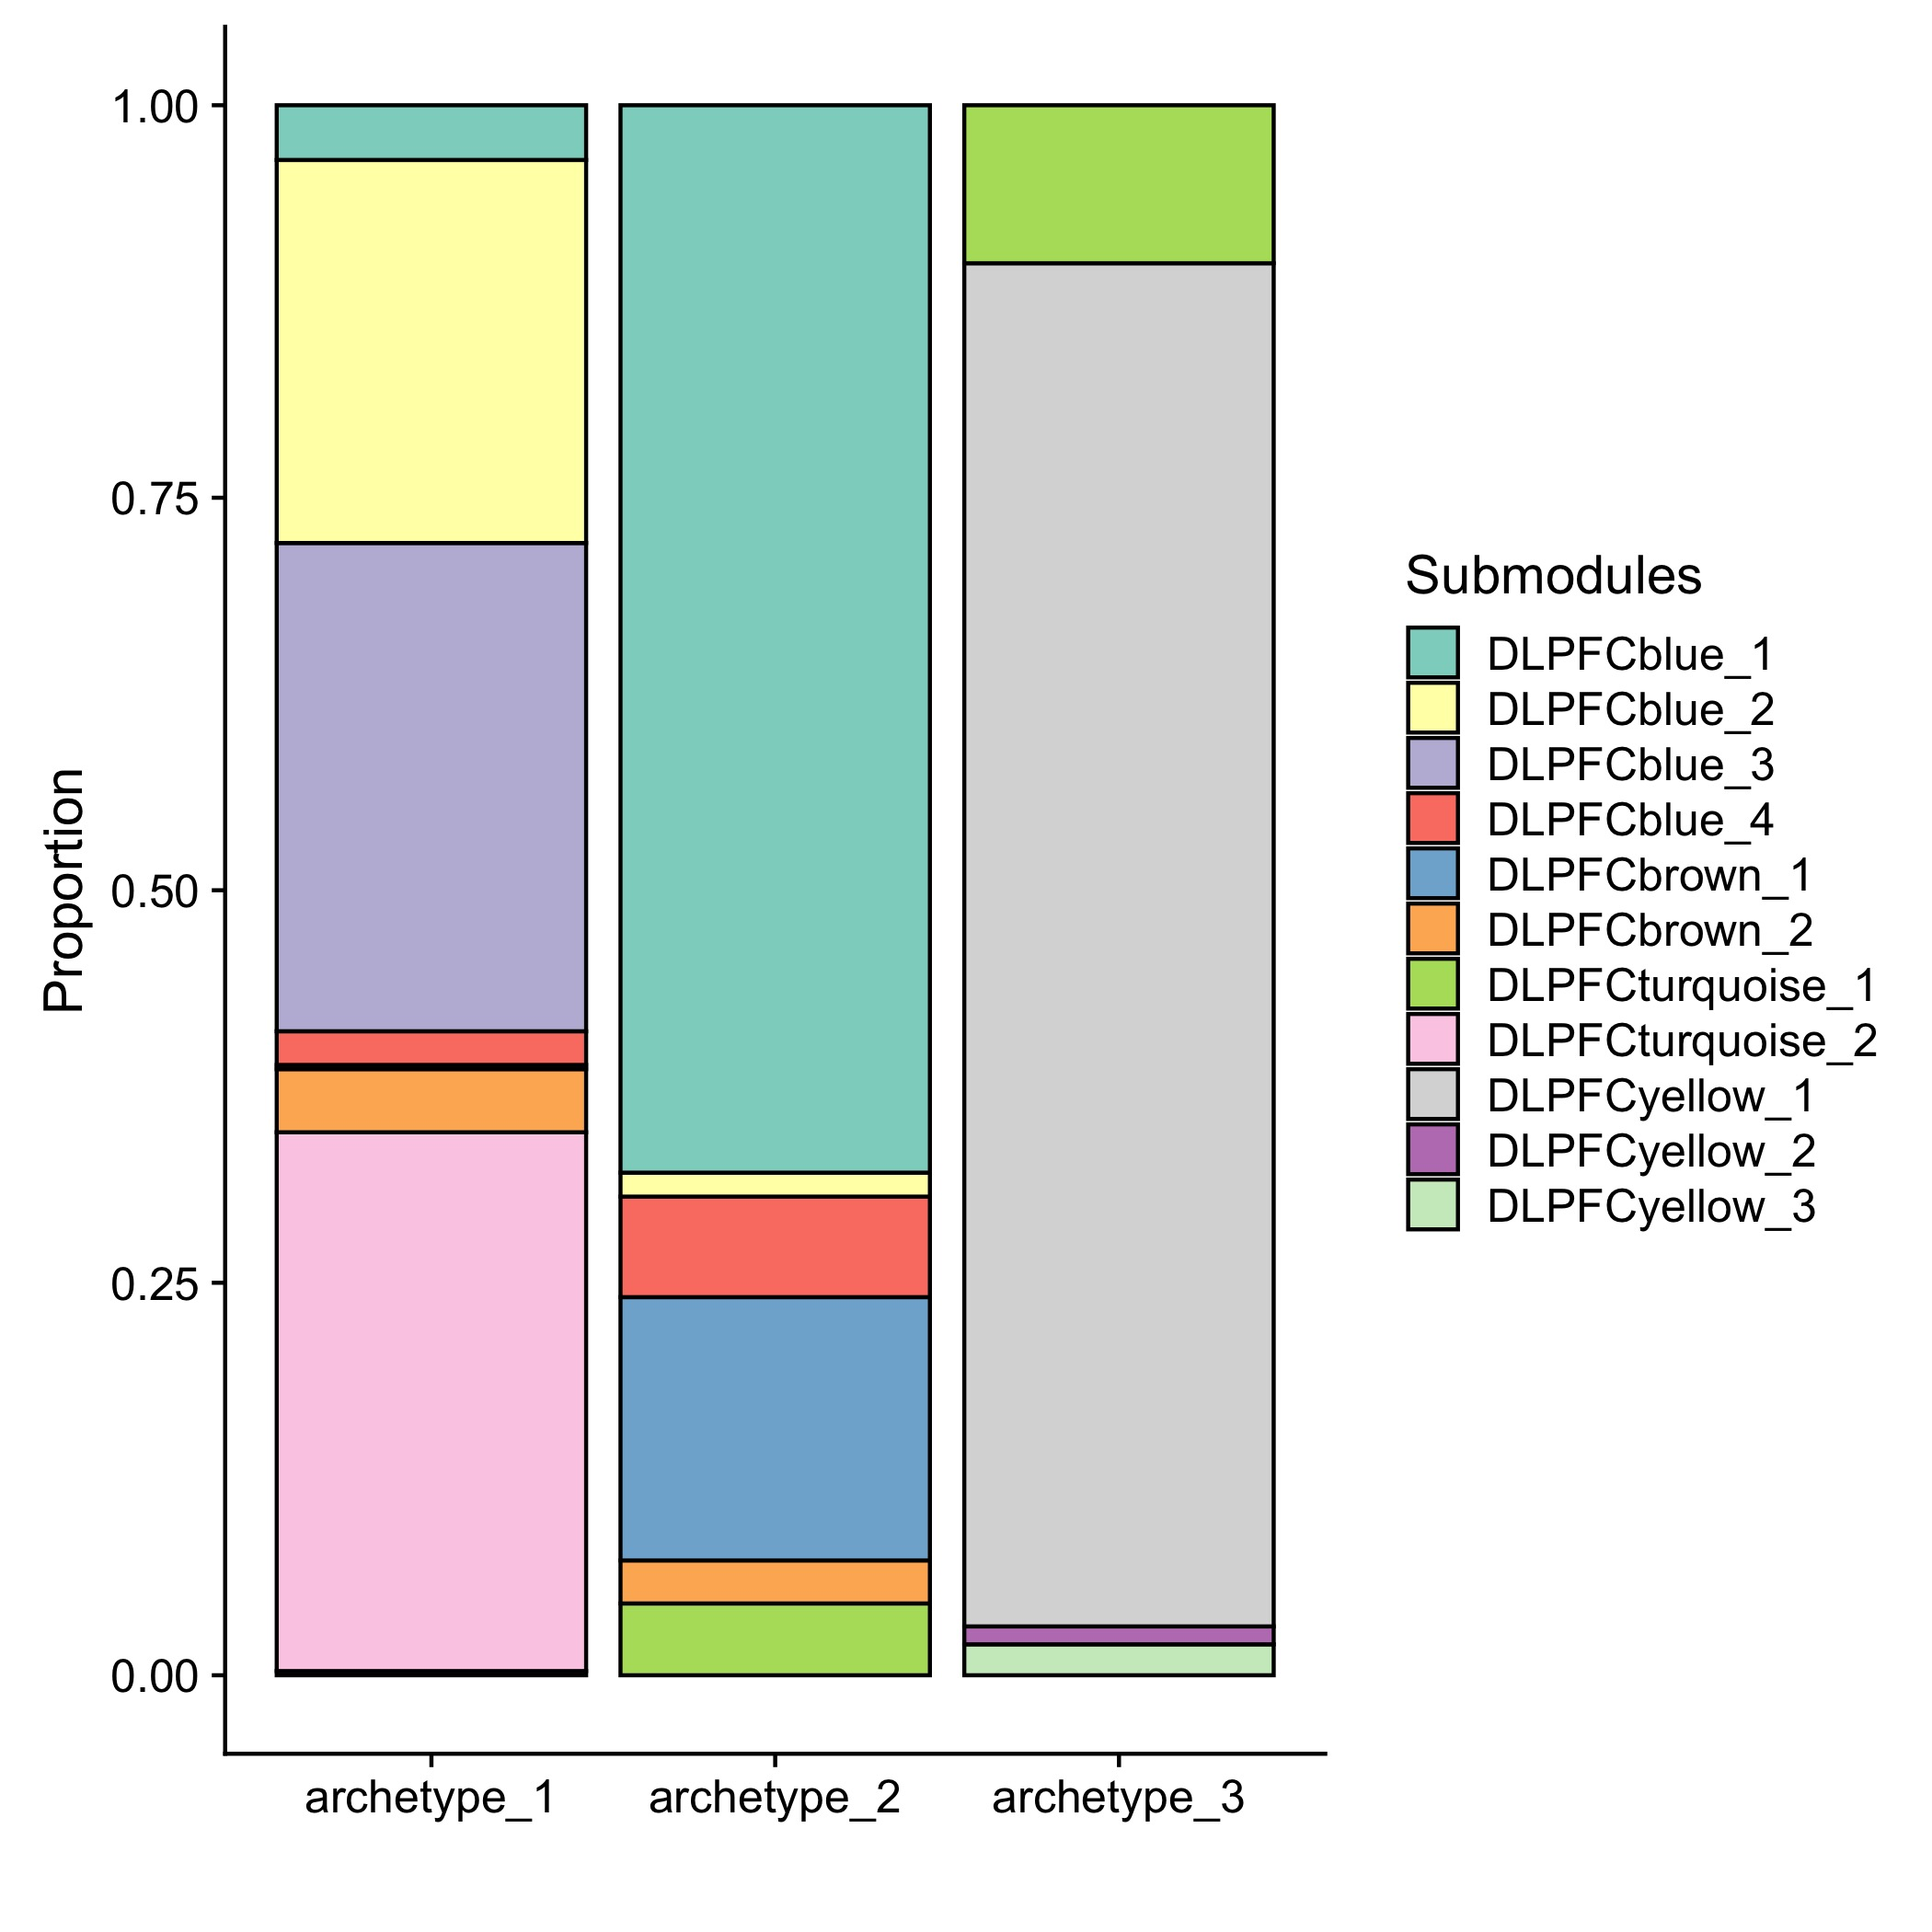
62% of the top genes are included in one of the submodules (80% in big modules)
Ng=626
Ng=551
Ng=1538
cytokine (immune) signaling
inflammatory
DLPFCyellow:neuronal
Synaptic signaling
microglial activation
immune response
protein folding
Stress response
astrocyte metabolism
oxydation-reduction
gliogenesis
oligodendrocytic myelination
A
A+B
B
Notes:
62% of the genes that I found are also in one of Nikil’s submodules.
The submodule breakdown among the archetypes matches their overlap with the subtypes that Nikhil found.
Arch3 is all yellow, which is strongly enriched for neuronal signature (cluster C in Ben’s paper).
Arch1 includes all the blues and turquoise2, so basically inflammatory-related (B,E).
Arch2 is again more of a mix – mostly blue1 and brown1 – possibly related to basic functions of glial cells (B,D)

Slide 14
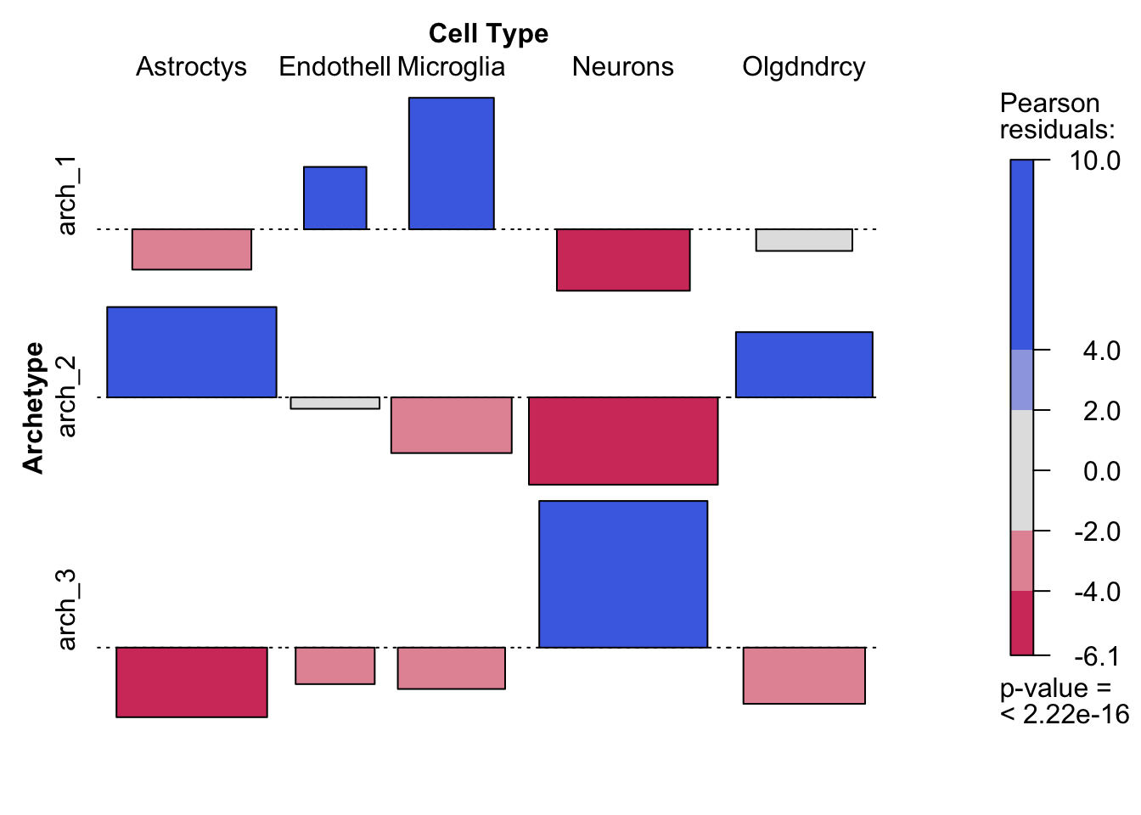
Cell-specific marker genes
Notes:
A very clear association with cell type markers consistent with GO annotation

Slide 15
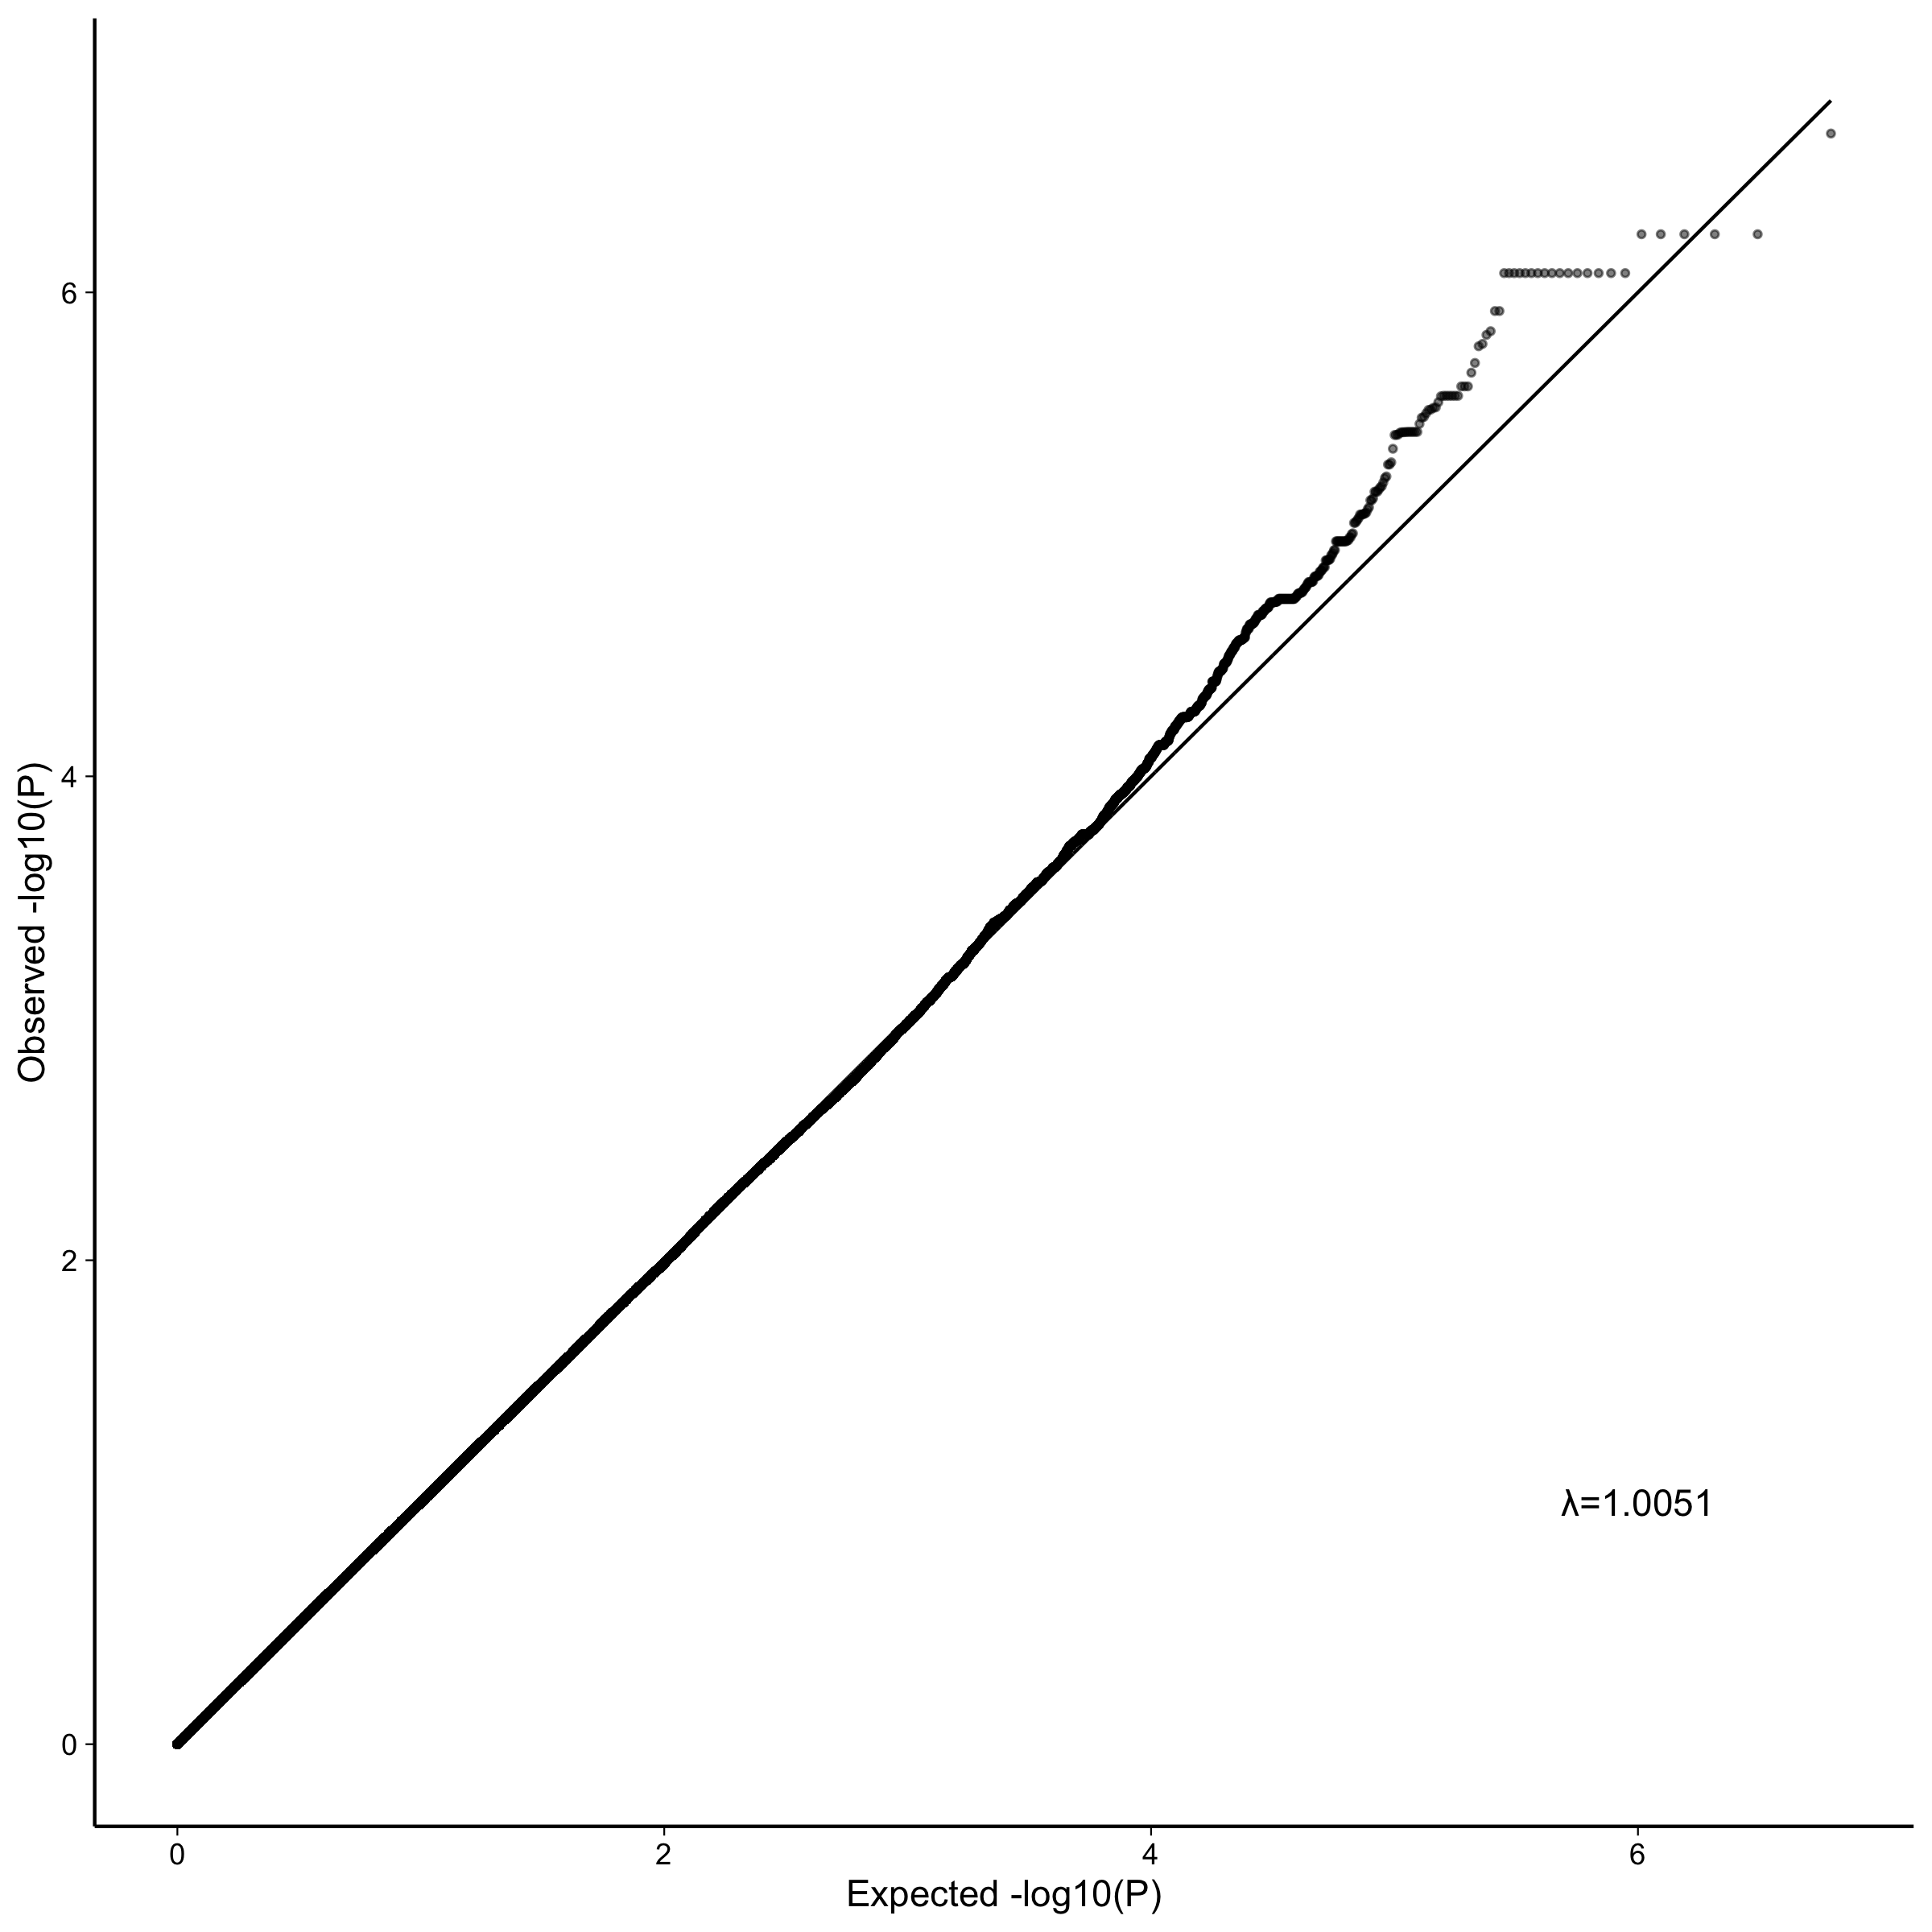
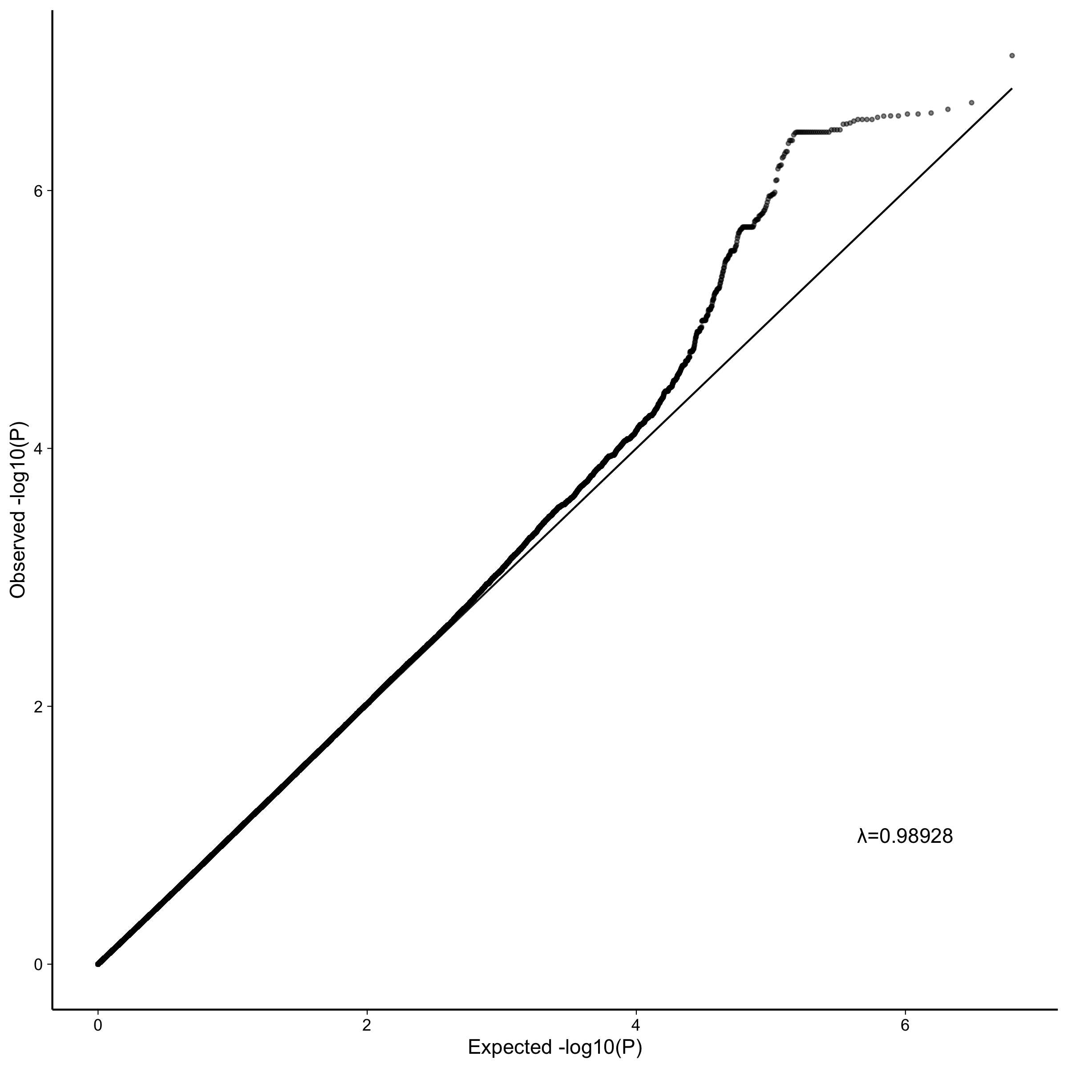
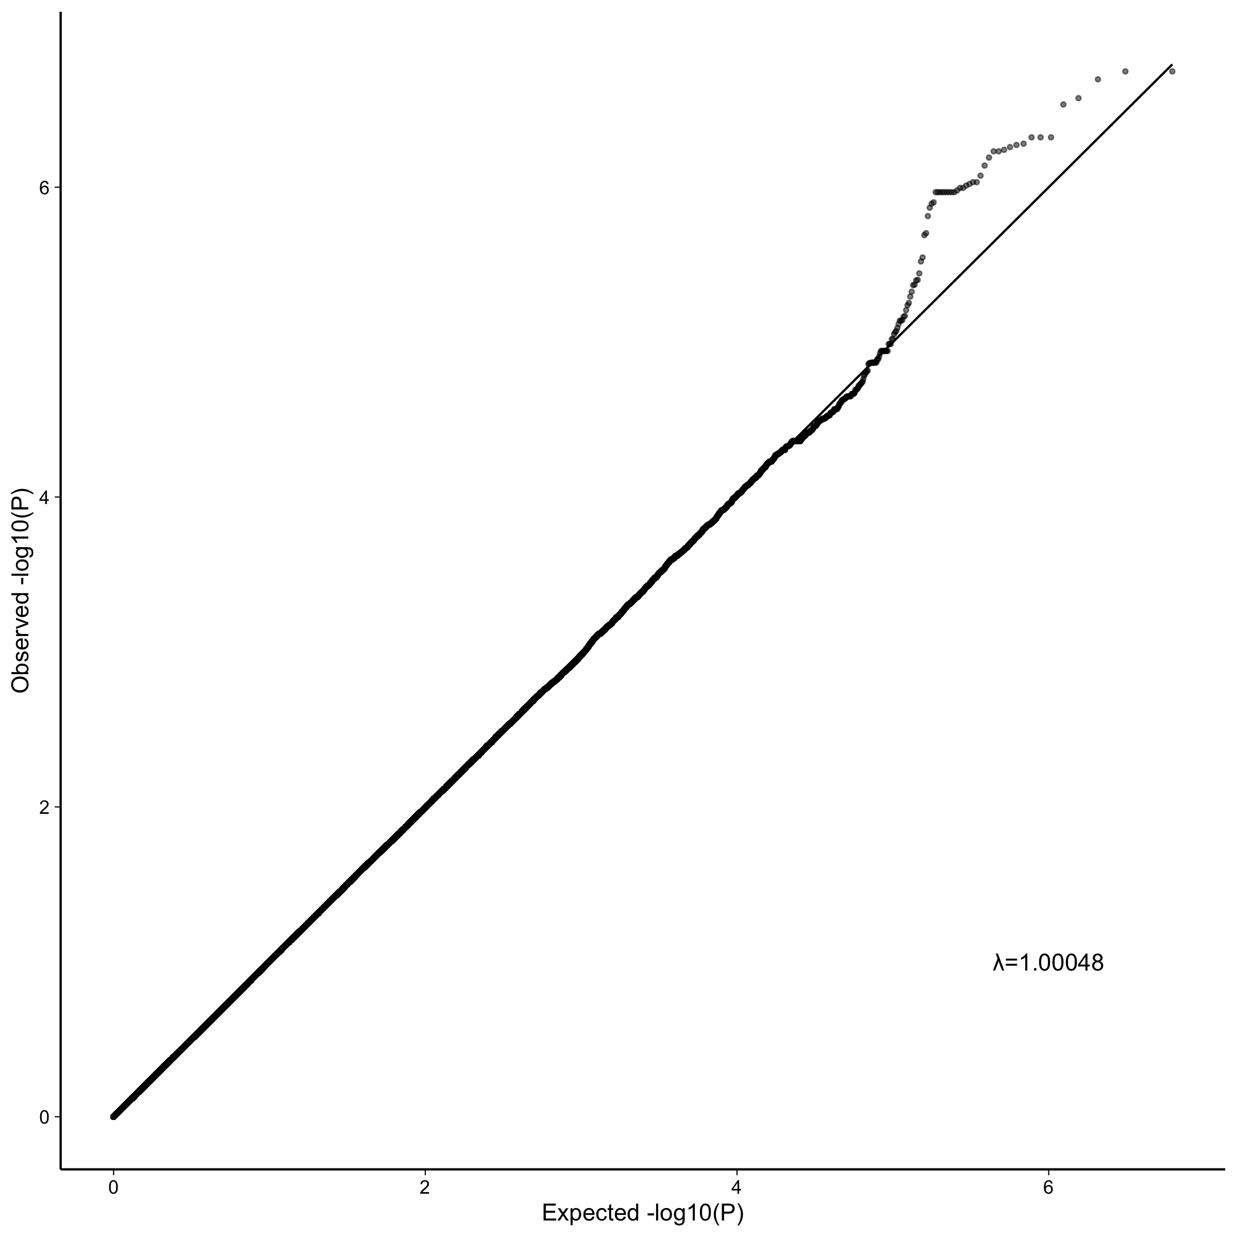
GWAS (EMMAX) of distance from each archetype for all samples
Archetype_1
Archetype_2
Archetype_3
Notes:
As an endophenotype for the GWAS, I calculated the distance of each patient from each archetype, including the non-AD patients. That gives us three different phenotypes for the gwas. Another phenotype was the classification of patients based on these distances.
The qq plots are what we expect from populations with no substantial substructure

Slide 16
Overlap of mapped genes between different phenotypes
C2orf48: ncRNA
SSBP3: transcription factor; collagen(?)
RGMB: cell adhesion/development
ANK1: cell motility/activation/proliferation
SLC14A2: cell adhesion; glucose/urea TM-transport
CSMD1: brain (cerebellum, hippocampus); glucose homeostasis, startle response
KCNA4: Potassium channels
RGS7: G-protein; K channels, signal transduction,
TMEM106B: transmembrane; interacts with apoe
BNC2: transcription factor; skin pigmentation, scoliosis
DLC1: cytoskeletal reorganization; tumor supressor
Notes:
I took all the suggestive snps and ran them through FUMA to map them to genes, and then, following Nikhil’s example, I generated a network from these genes to see the structure of overlap between the different phenotypes.
The main point for now is that the archetypes do not overlap in the genetic associations, but subtype A from Mikhil's work overlaps with both archetype 1 and archetype 2
So here I combine the mapped genes from my archetype analysis with those from Nikil’s analysis for the subtypes as well as clinical phenotypes (in red)
Looking at the architecture without submodules first:
In accord with what we found based on the gene expression alone:
Subtype A overlaps with archetypes 1 and 2, while subtype B overlaps with archetype 3.
Archetypes don’t overlap directly among themselves - and same for the subtypes (which we already knew from Nikhil’s work). So again it looks like we're breaking down subtype A into two separate classes in terms of the genetic underpinnings.
Clinical phenotypes don’t overlap much with the GE phenotypes. But, archetype 2 has one gene in common with clinical diagnosis and archetype 3 has one gene in common with cerad score, and that overlap isn't there when mapping based on subtypes
So you could say that we're breaking down subtype A into two separate genetic underpinnings.
The two genes shared between subtype A and archetype 1 are somewhat obscure and not clear how they relate to AD
But the three genes shared between subtype A and archetype 2 all related to cellular functions and glucose transport which is somewhat in accord with its annotation as related to gliogenesis and metabolism
The gene shared between archetype 2 and clinical diagnosis is also related to glucose metabolism and brain function
The three genes shared between subtype B and archetype 3 are all highly expressed in the brain and involved in potassium channels and neuronal signal transduction, again in accord with this being the neuronal archetype.
TMEM106B is well known to pop up in LOAD GWAS and interact with APOE

Slide 17
Conclusions (1):
Archetype analysis allowed stratifying ROSMAP patients into three classes instead of two
Archetype 1 and 3 largely correspond to subtype A and B, respectively; archetype 2 is more mixed, including more MCI cases
A clear distinction between archetypes in their functional annotation
Non-overlapping GE modules
Archetype 1: inflammation
Archetype 2: metabolism, cellular functions, oxidative stress
Archetype 3: Neuronal function
Archetypes 1 and 2 break down subtype A in terms of genetic underpinning

Slide 18
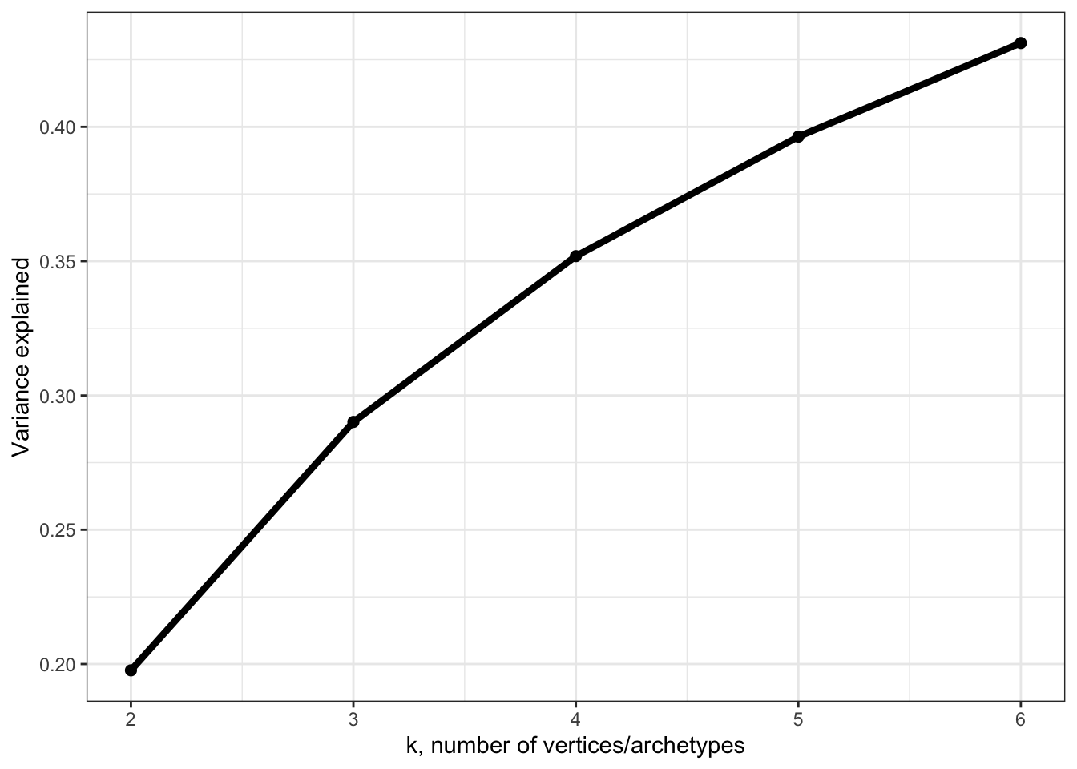
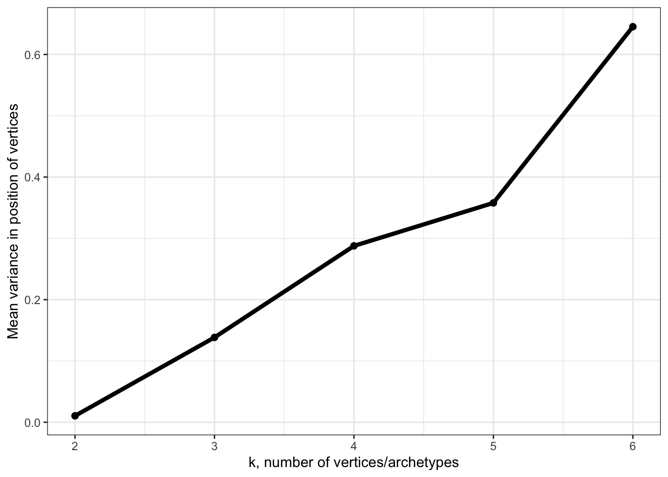
Proteomics (TMT-labeled MS/MS-based): No polytope fits the data well
6 archetypes explain less than 50% of the variance
Variance around archetype positions is very high
(Variance around RNAseq archtypes ~ 3% on average)

Slide 19
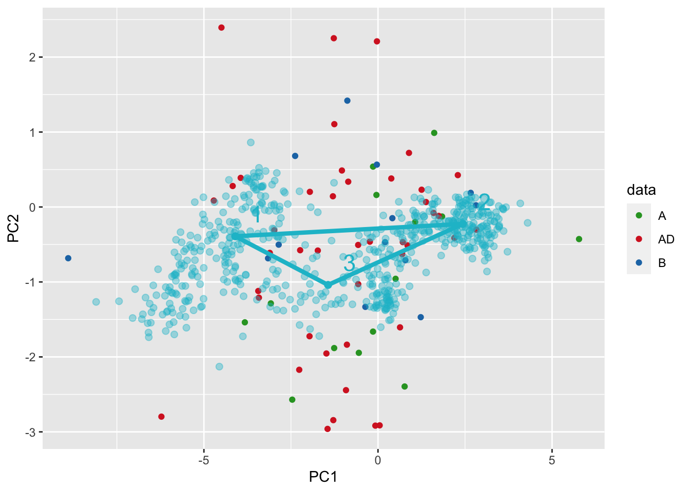
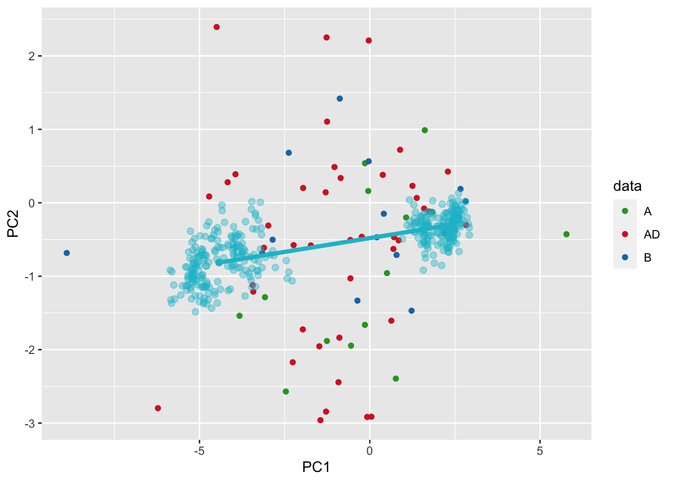
Proteomics (TMT-labeled MS/MS-based): No polytope fits the data well

Slide 20
Proteomics (TMT-labeled MS/MS-based): No polytope fits the data well

Slide 21
Alternatively:
Align proteomics samples with rnaseq using patients for which we have both
-> using Procrustes superimposition
Impute position of rnaseq-based archetypes in the proteomics space
Reconstruct proteomics profile of each archetype (annotate, etc.)

Slide 22
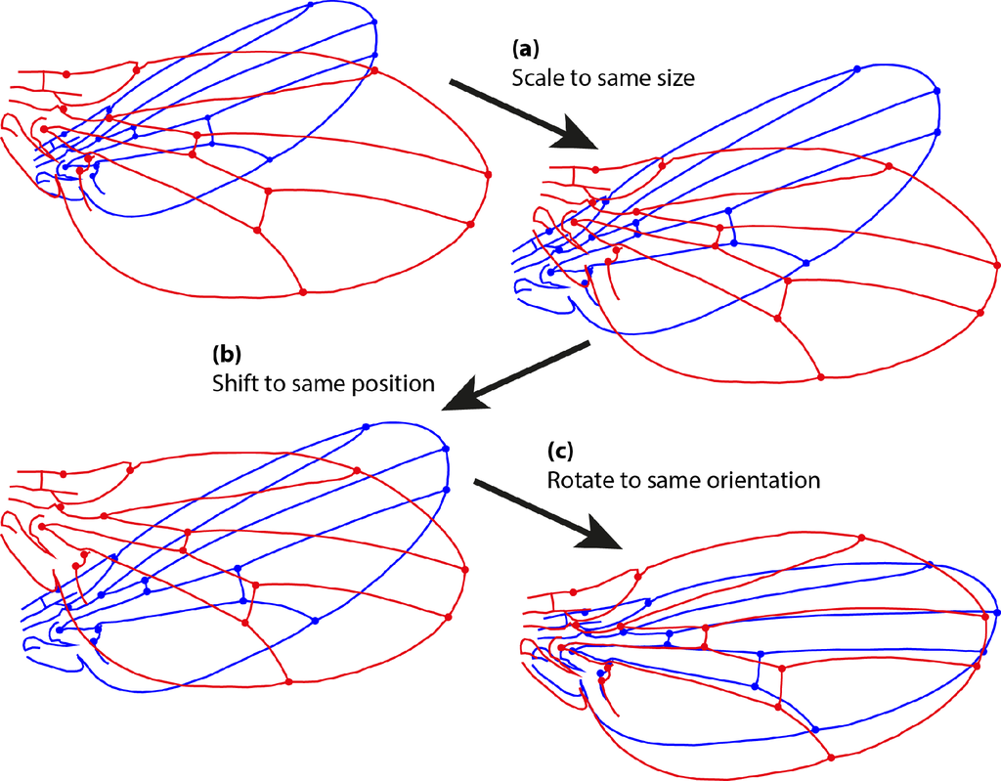
Procrustes superimposition: least-square-fit
Notes:
the first thing we need to do is to align the PCA results from the proteomics and rna seq data so that two spaces are comparable.
This is commonly done using Procrustes superimposition, which is a least-square-fit procedure, often used to register images in image analysis, or align specimens in morphometrics.
This procedure removes differences due to size, location, and orientation, so all we are left with – by definition - is the difference in the shape of these two configurations of points.
In this case the configuration of points are landmarks defining the fly wing, but when we compare PCA results, the configuration of points is given by the PCA scores.
This is a rigid rotation: it preserves the distances between the points within each configuration.
So this is similar to CCA, both are designed to compare two sets of variables measured on the same set of samples. When we compare mouse and human data, we have the opposite situation - the same set of variables for two different sets of samples, so we need to transpose the matrices for either methods and then we're aligning the variables rather than the samples. This is not the typical way to use these methods, but it is technically possible. The fundamental difference between Procrustes and canonical correlation analysis is that PS is a rigid rotation, which means that it preserves the distances between samples within each space (basically the shape of the configuration), which isn't so for CCA. Because I ultimately want to infer the proteomic profiles of the archetypes, which are themselves inferred relative to the configuration of the rnaseq samples, it is more important here I think to preserve their relative distances.
The other good thing about PS is that it can be generalized to include endless number of configurations to be compared simultaneously. It doesn’t have to be pairwise comparisons. That makes it useful for comparing many ordinations simultaneously and also for imputing any missing data at the PCA level because the PCA scores can be bootstrapped and then the bootstrapped spaces can be superimposed to get the estimate of the missing points with CI around them.

Slide 23
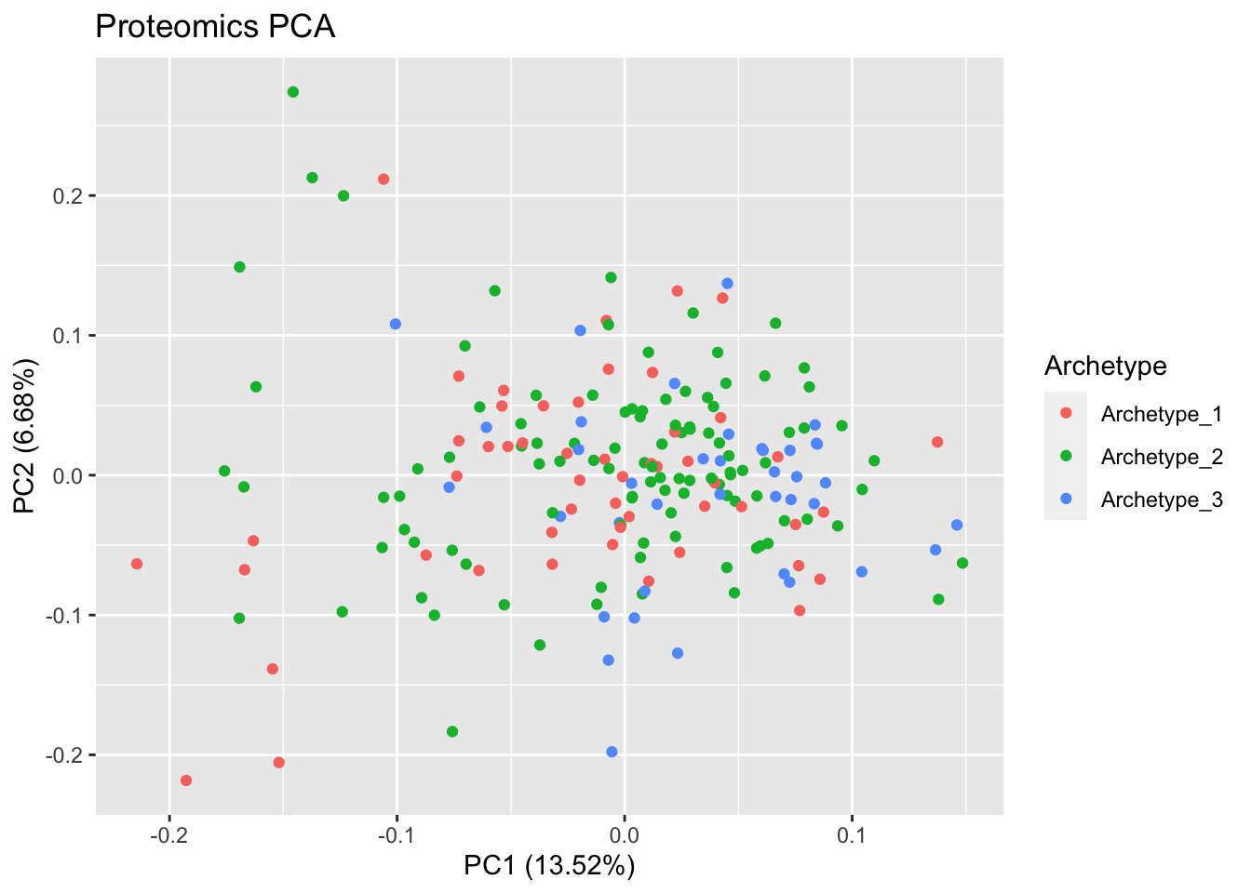
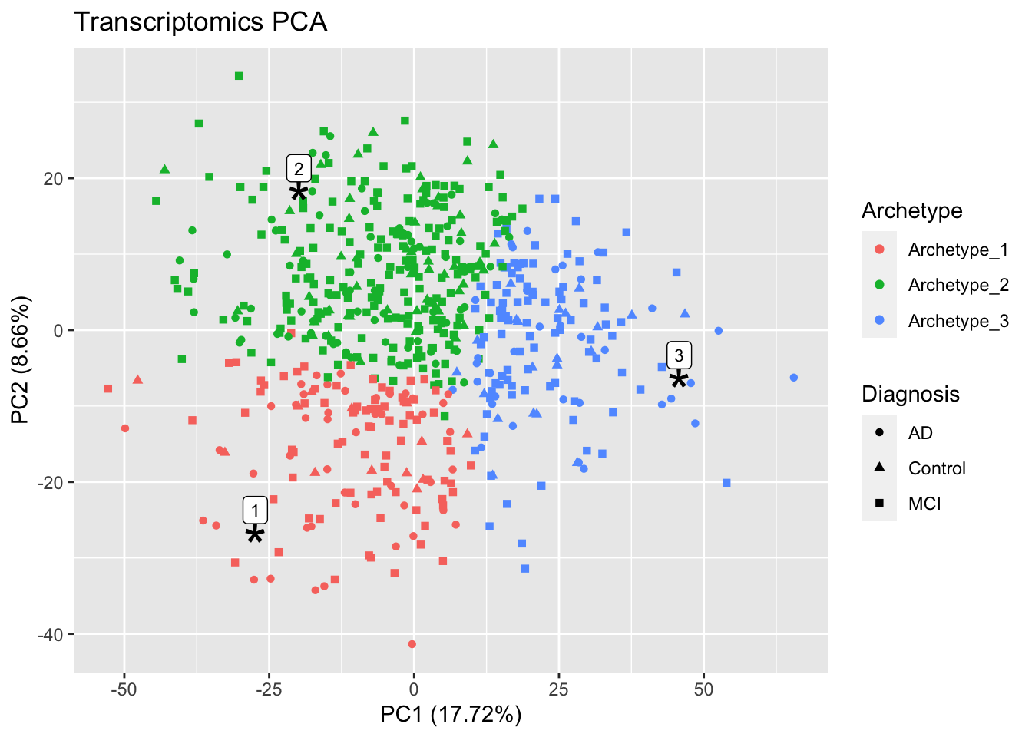
Notes:
This is what the two spaces look like before superimposition. The archetypes are distributed very differently so not likely to align well.

Slide 24
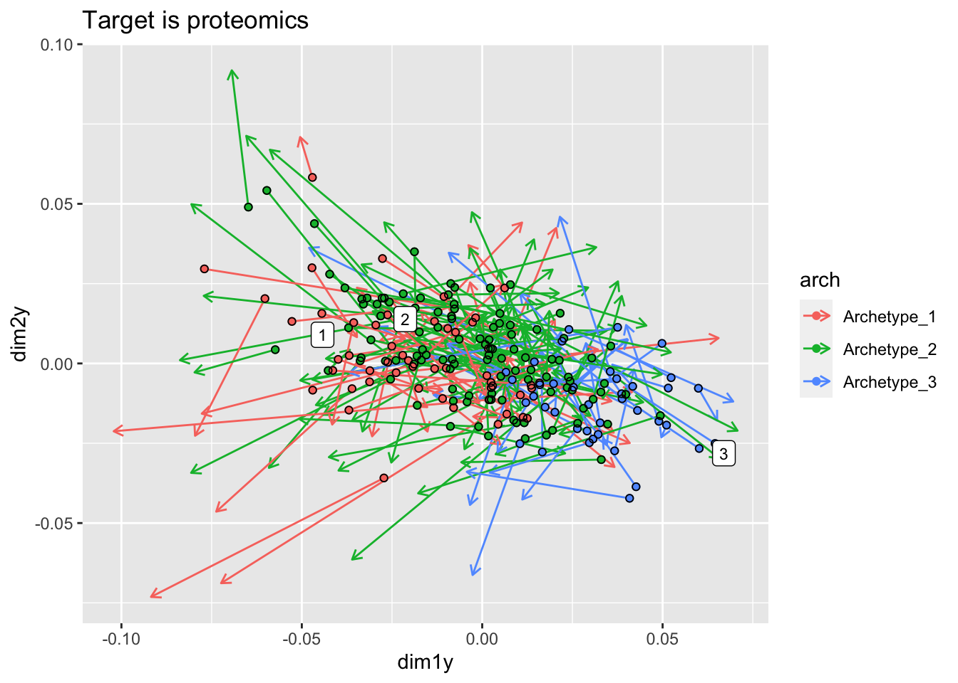
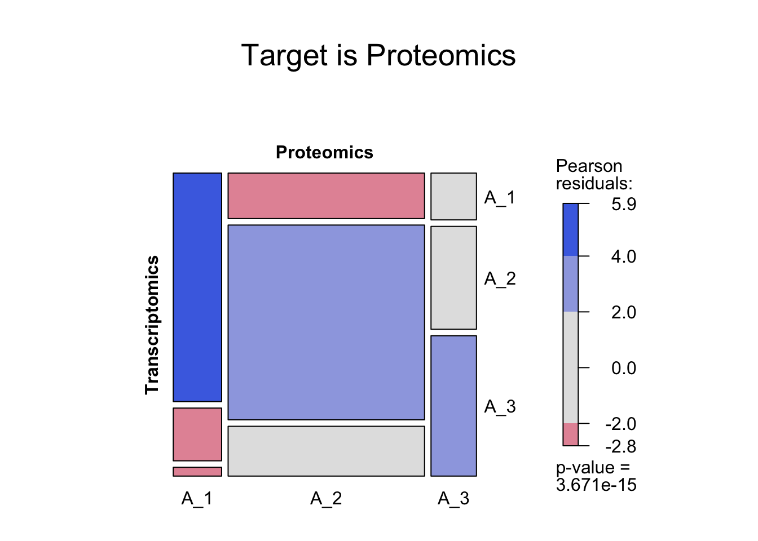
GE space superimposed onto the proteomics space (proteomics matrix is fixed)
Confusion matrix
Notes:
The GE space superimposed onto the proteomics space.
Points are the GE samples, colored by archetype, and arrows point to the position of the same patient in proteomics space. Therefore, length and direction of arrows give the magnitude and direction of the residuals from aligning the two spaces. The numbers indicate the imputed position of the archetypes themselves.
Archetype 3 seems better aligned than 1 and 2. Looks more like 1 and 2 combined to one class in proteomics, so two archetypes instead of 3.

Slide 25
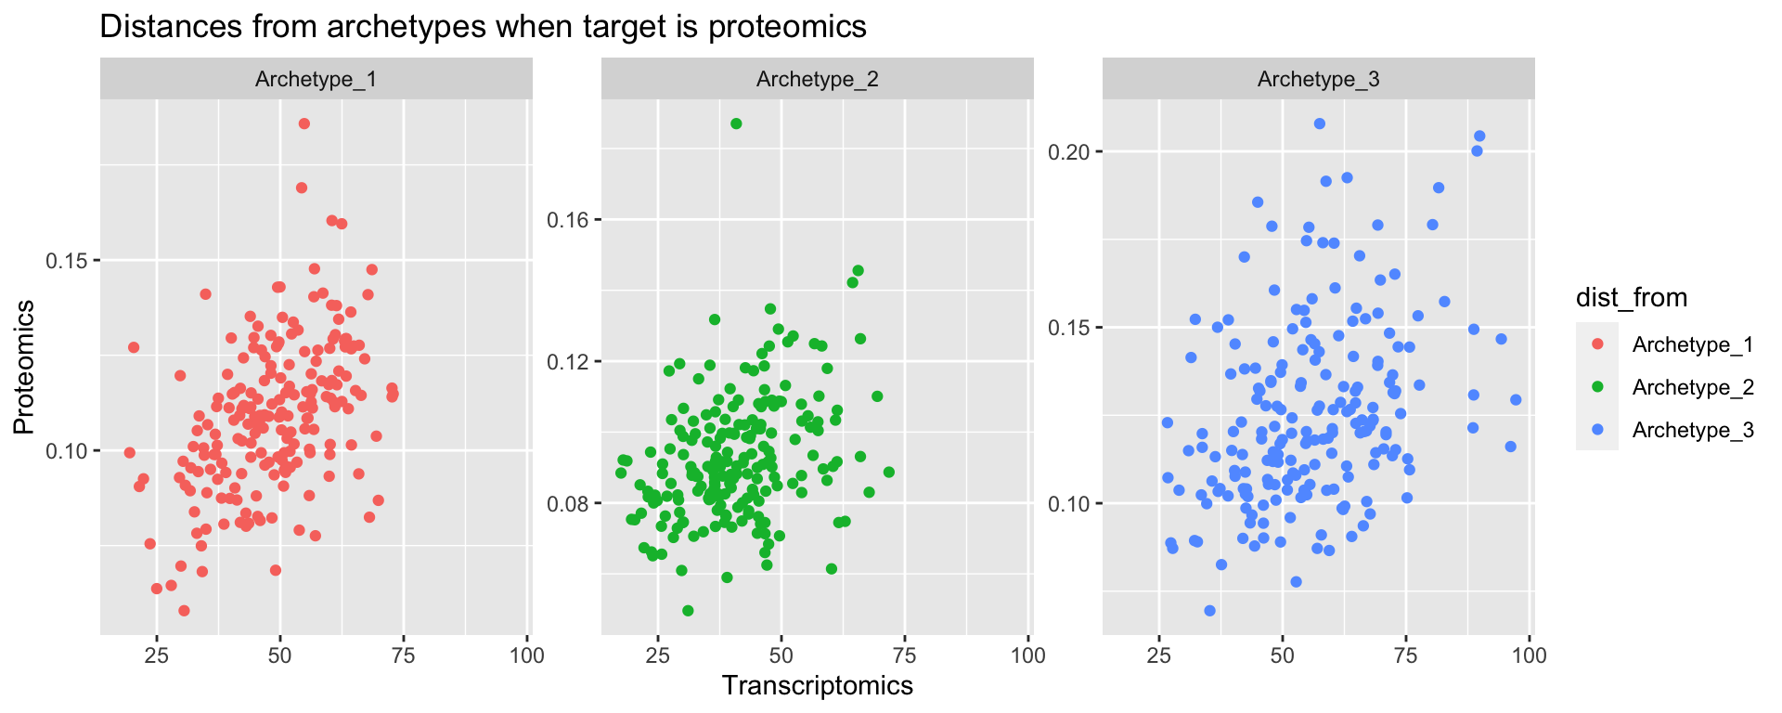
Distances from archetypes in the proteomics space compared to GE space

Slide 26
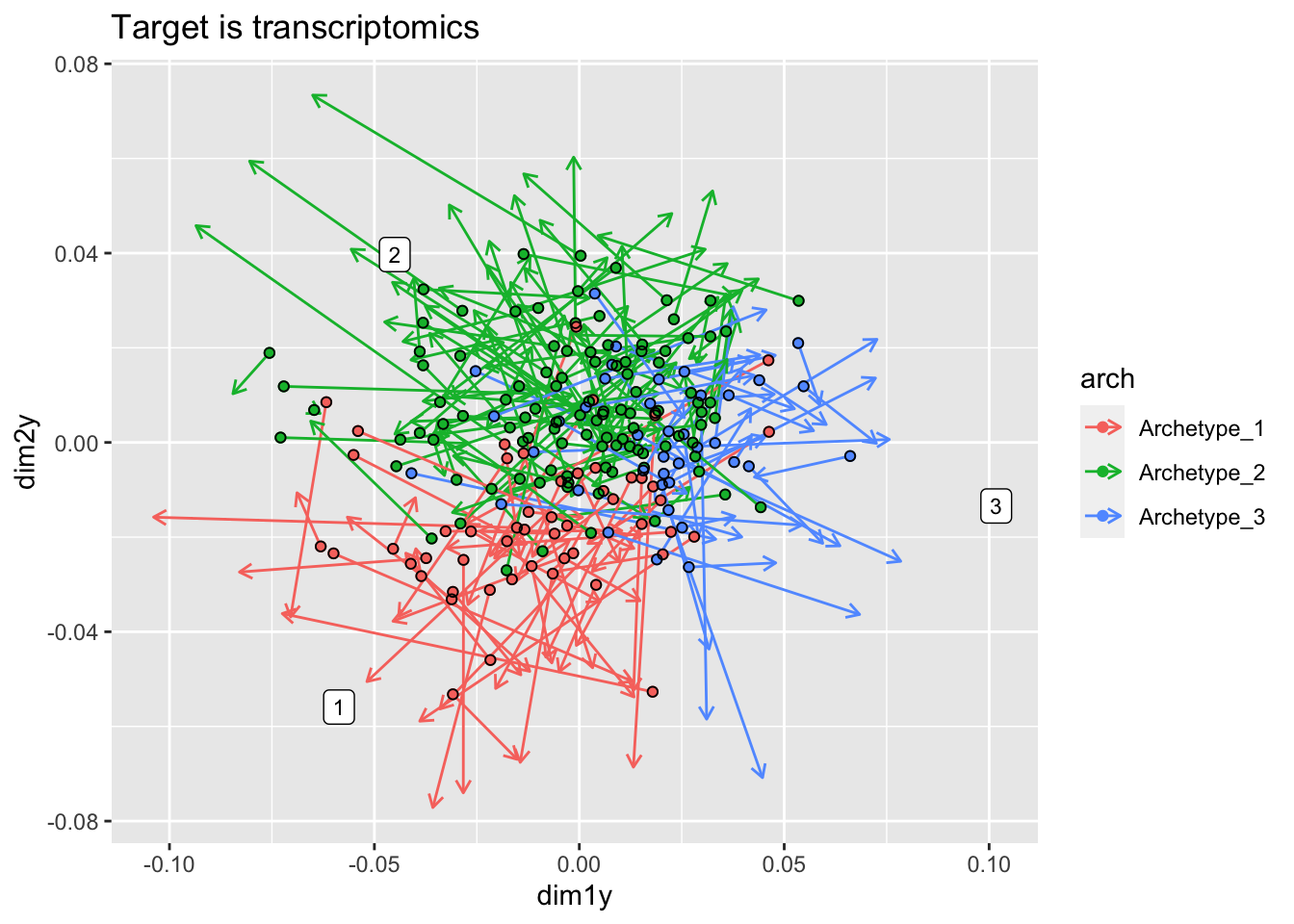
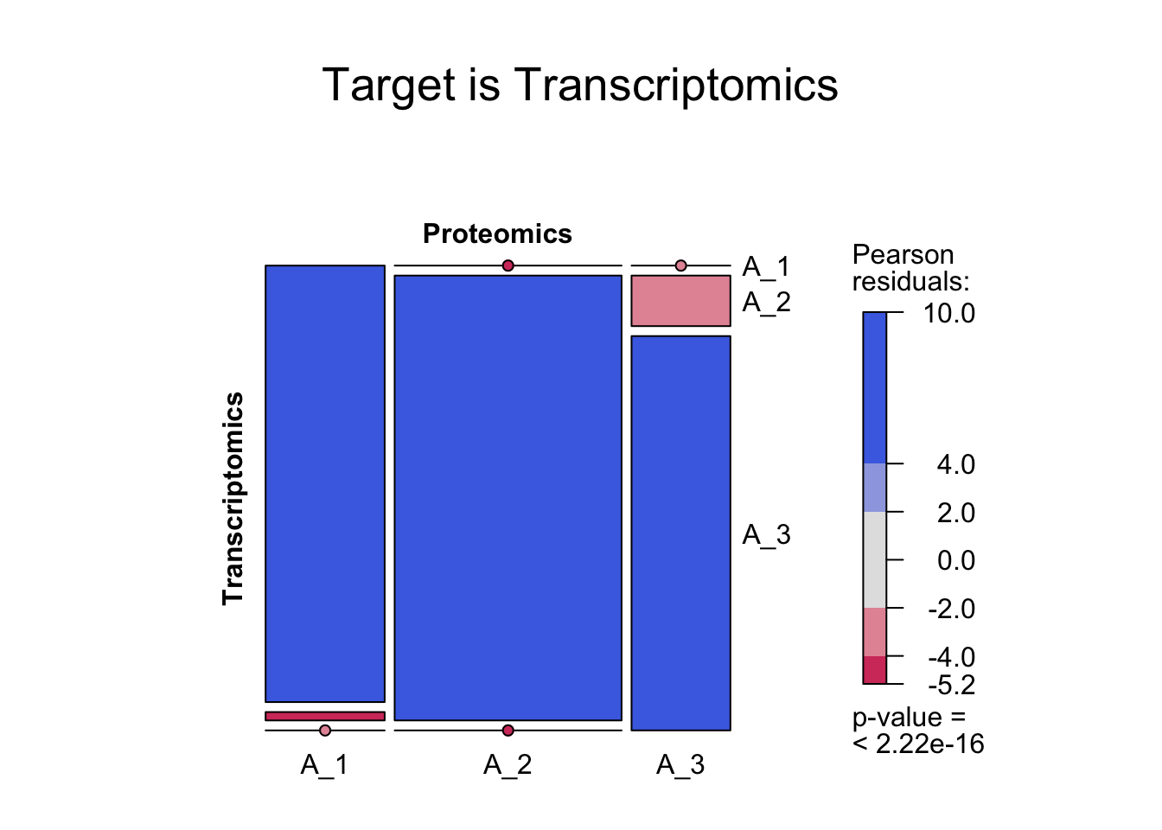
Proteomics space superimposed onto the GE space (GE matrix is the target)

Slide 27
Play with the normalization of the proteomics data?
Try other methods for comparing and integrating ordinations?
https://journals.plos.org/ploscompbiol/article?id=10.1371/journal.pcbi.1007677
→
Repeat with subspaces that correlate better
CCA to identify subsets of highly correlated gene-protein sets

Slide 28
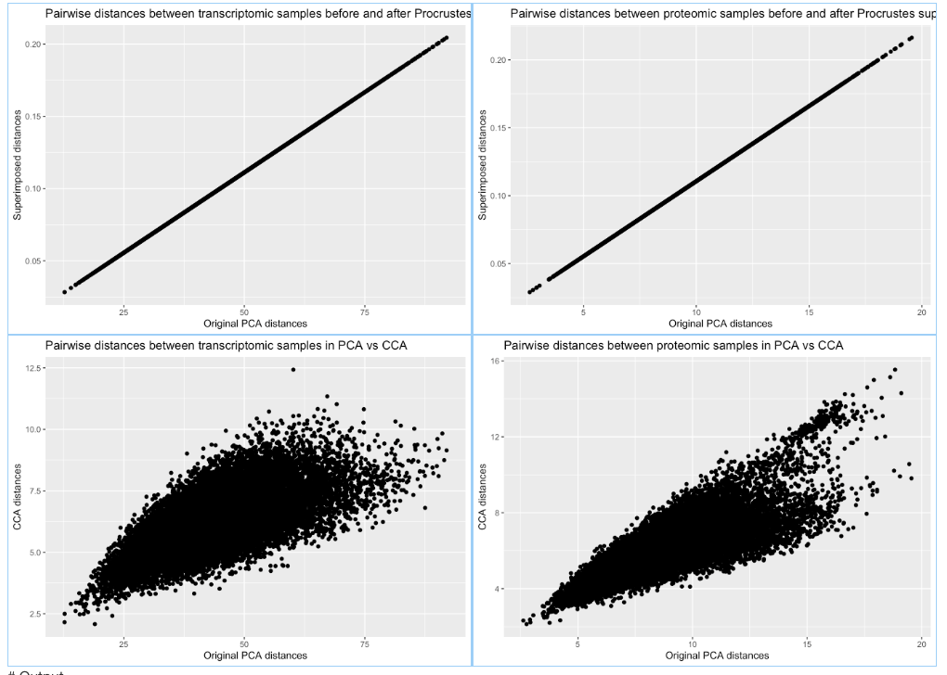

Slide 29
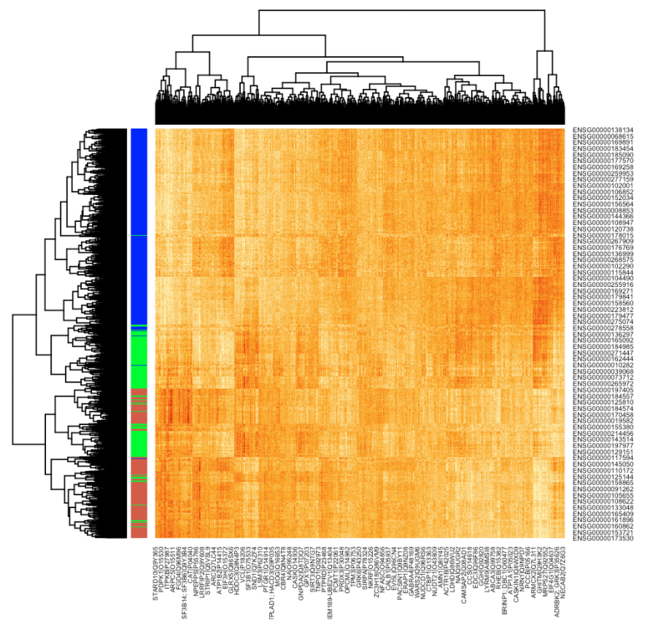
Notes:
Protein-gene pairwise correlations
Archetype_1 = coral; Archetype_2 = green; Archetype_3 = blue

Slide 30
References for applying archetype analysis to biological systems:
Hart, Y., Sheftel, H., Hausser, J., Szekely, P., Ben-Moshe, N. B., Korem, Y., … Alon, U. (2015). Inferring biological tasks using Pareto analysis of high-dimensional data. Nature Methods, 12(3), 233–235. https://doi.org/10.1038/nmeth.3254
Shoval, O., Sheftel, H., Shinar, G., Hart, Y., Ramote, O., Mayo, A., … Alon, U. (2012). Evolutionary Trade-Offs, Pareto Optimality, and the Geometry of Phenotype Space. Science, 336(6085), 1157 LP-1160. https://doi.org/10.1126/science.1217405
Korem, Y., Szekely, P., Hart, Y., Sheftel, H., Hausser, J., Mayo, A., … Alon, U. (2015). Geometry of the Gene Expression Space of Individual Cells. PLOS Computational Biology, 11(7), e1004224. https://doi.org/10.1371/journal.pcbi.1004224
Sheftel, H., Shoval, O., Mayo, A., & Alon, U. (2013). The geometry of the Pareto front in biological phenotype space. Ecology and Evolution, 3(6), 1471–1483. https://doi.org/10.1002/ece3.528

Slide 31
Notes:
Relaxing the assumption that a task is represented by a point rather than a region

Slide 32
Example: Single-cell gene expression data from human colon crypt cells
K = 4
D = K-1 = 3
Four vertices (Tetrahedron) explains 45% of the variance
Three PC’s explain 95% of the variance
Distributed kinda sort of like a tetrahedron
Korem et al 2015
Notes:
Looking at an example from their paper:
They analyze single-cell expression data from human colon crypt cells, and calculated the variance explained by the best-fit polytopes that encompass the data, starting with 2 archetypes, basically a line, and adding one vertex at a time. They find that the first bend in this curve yields 4 vertices, so a tetrahedron, explaining 45% of the variance. The classical PCA scree plot also shows 4 significant dimensions, where the first 3 explain 95% of the variance and the forth doesn’t really add much, so effectively 3 dimensions as predicted. And the data distribution in these 3 dimensions actually does look a bit like a tetrahedron.

Slide 33
Example: Single-cell gene expression data from human colon crypt cells
Each of the archetypes shows high expression of a set of markers typical of a specific crypt cell type
Korem et al 2015
Notes:
Looking at the expression profiles of points closest to each of the vertices we can infer the biological function of each archetype, and we can see here that it does match the expectation based on the cell types that we know exist in this example based on specific markers

Slide 34
Main attributes and advantages:
The orientation of the archetypes does not generally align with the PC’s, implying that the biological meaning of the archetypes is distinct from that carried by the PCA components.
Less sensitive to sampling error
Avoids the problem of determining cluster boundaries that are usually fuzzy
Reducing dimensionality beforehand is not necessary
Small sets of genes (traits) with small but biologically-relevant effect will be lost
Notes:
They analyzed several datasets from different biological contexts in a series of papers.
To summarize the important points that they found:
First and foremost: The orientation of the archetypes does not generally align with the first PC, implying that the biological meaning of the archetypes is distinct from that carried by the PCA components.
Hyperspectral unmixing algorithms for determining the position of the archetypes. And the elbow in the explained variance function to identify the number of dimensions. 5 different algorithms are implemented in their Matlab package.
In addition:
Less sensitive to sampling error
Avoids the problem of determining cluster boundaries that are usually fuzzy
Reducing dimensionality with PCA beforehand is not necessary
But:
Small sets of genes (traits) with small but biologically-relevant effect will be lost (a follow-up paper tries to work around it by giving different weights to different genes based on a priori knowledge of their relevance)
(Also, can calculate the clumpiness of the data by the ratio of local density of the data to that expected for a randomized dataset [Korem et al])

Slide 36
~ 20 non-random PC’s explain only 17%
~ 400 pc’s explain 80%
Notes:
Looking at the distribution of the data in general: the first 20 PC’s explain more variation than expected by chance using the broken-stick model as the null distribution.
But these 20 PC’s only explain a total of 17% of the variance so I repeated everything using 400 pc’s – 80% - of the variance and that gave essentially the same results, so we’ll stick with 20 PC’s from now on.

Slide 37
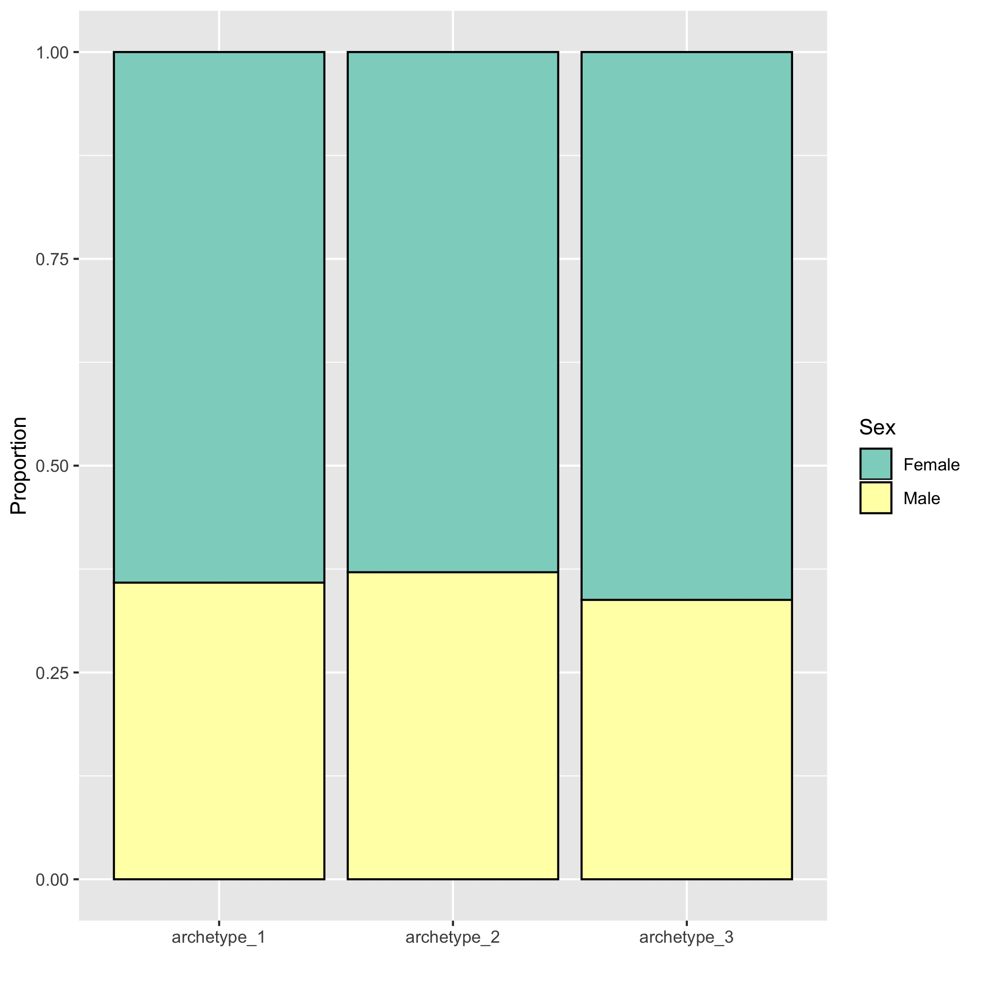
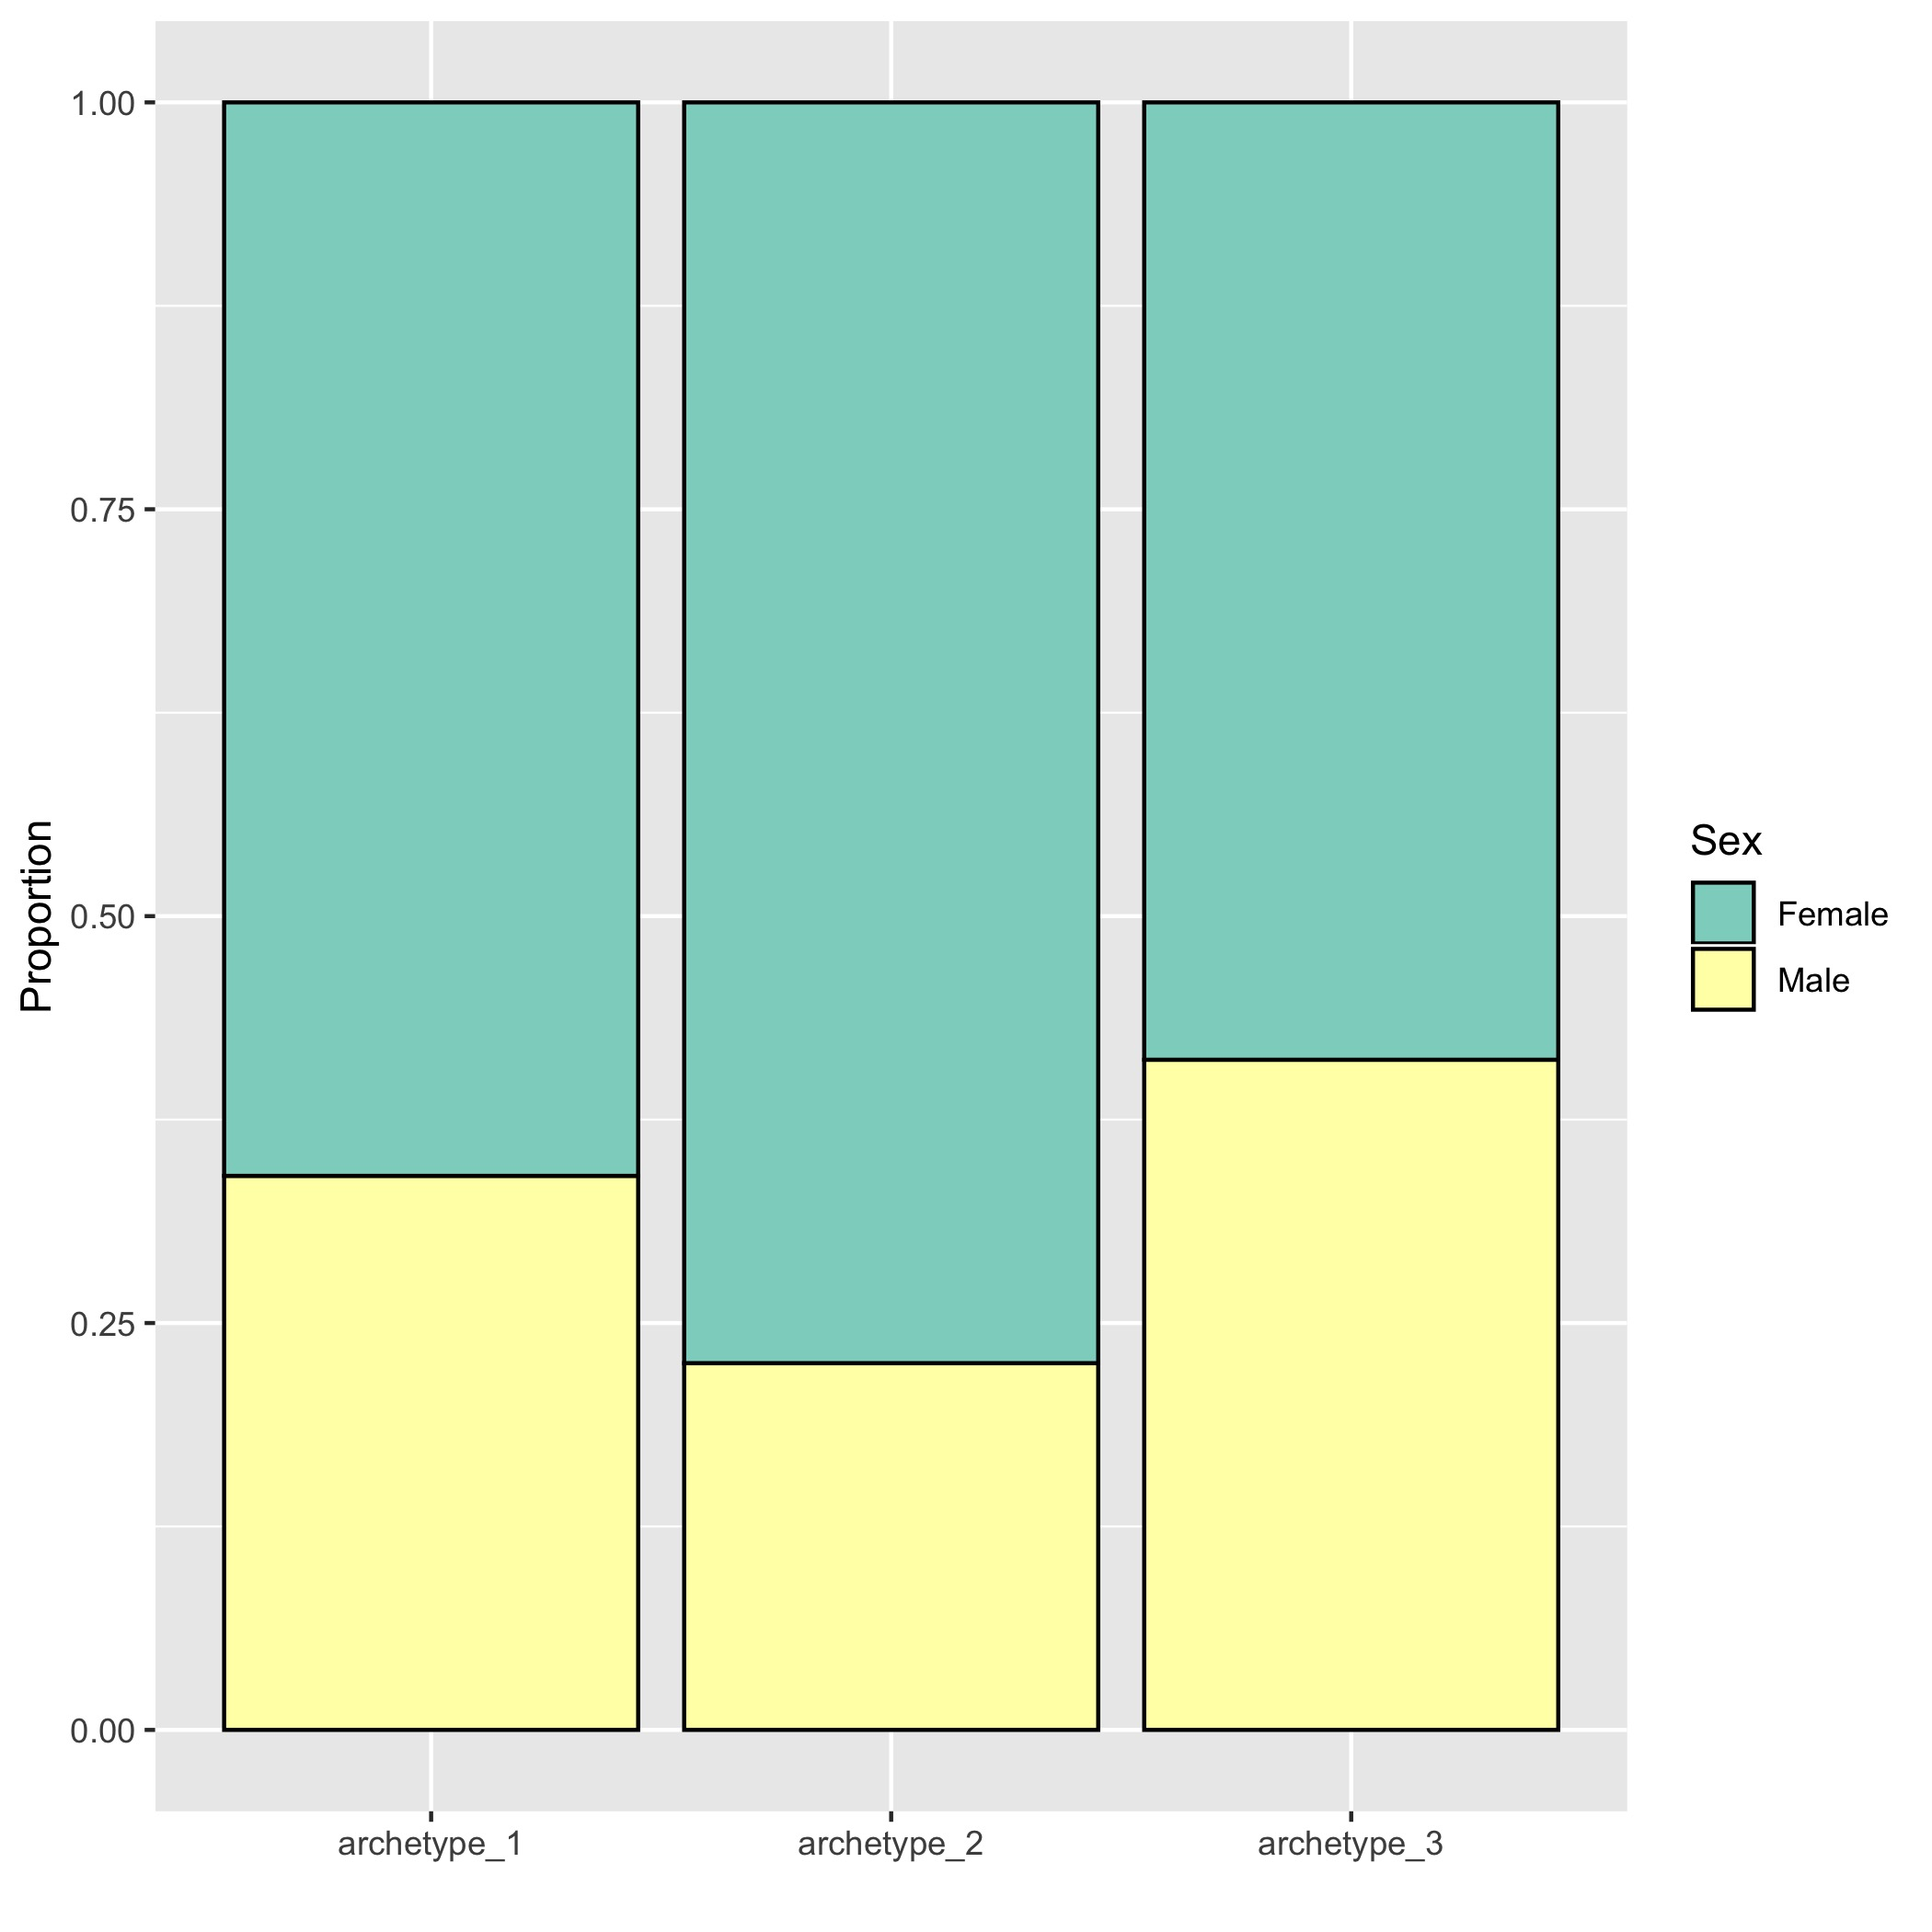
All samples (AD, MCI+others, control)
AD patients only
Notes:
Archetype 2 has relatively more females AD patients

Slide 38
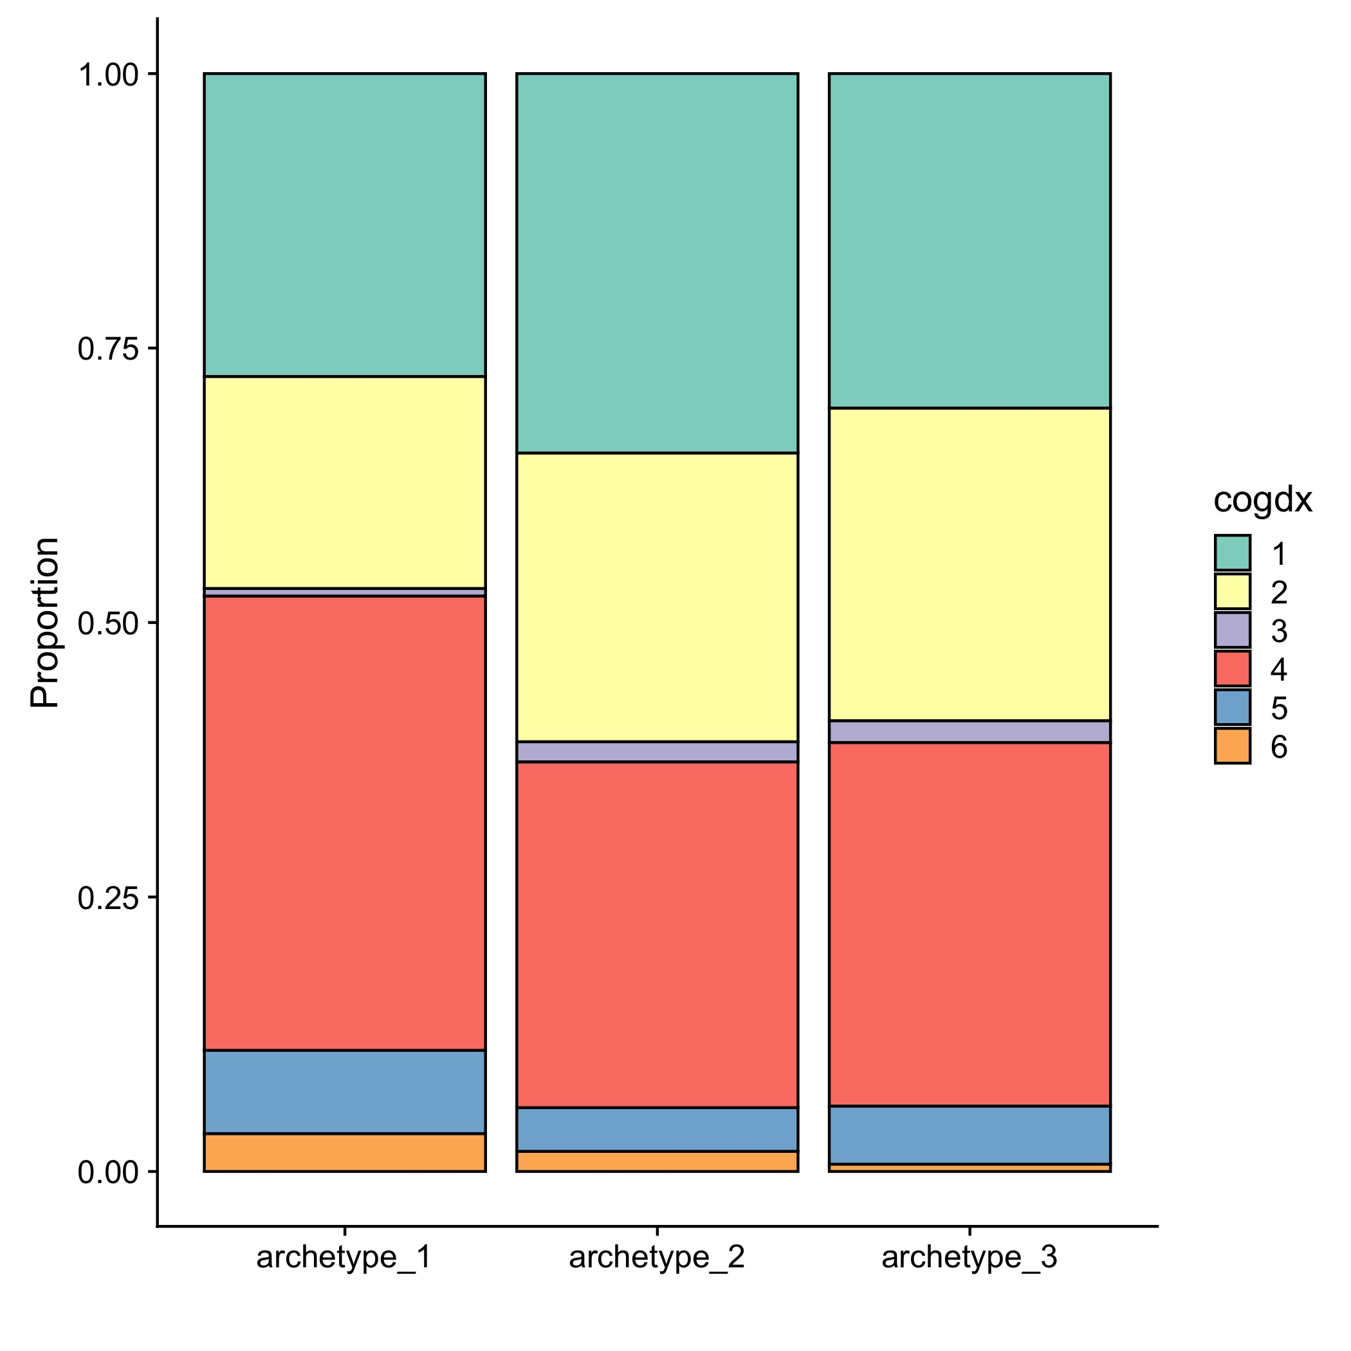
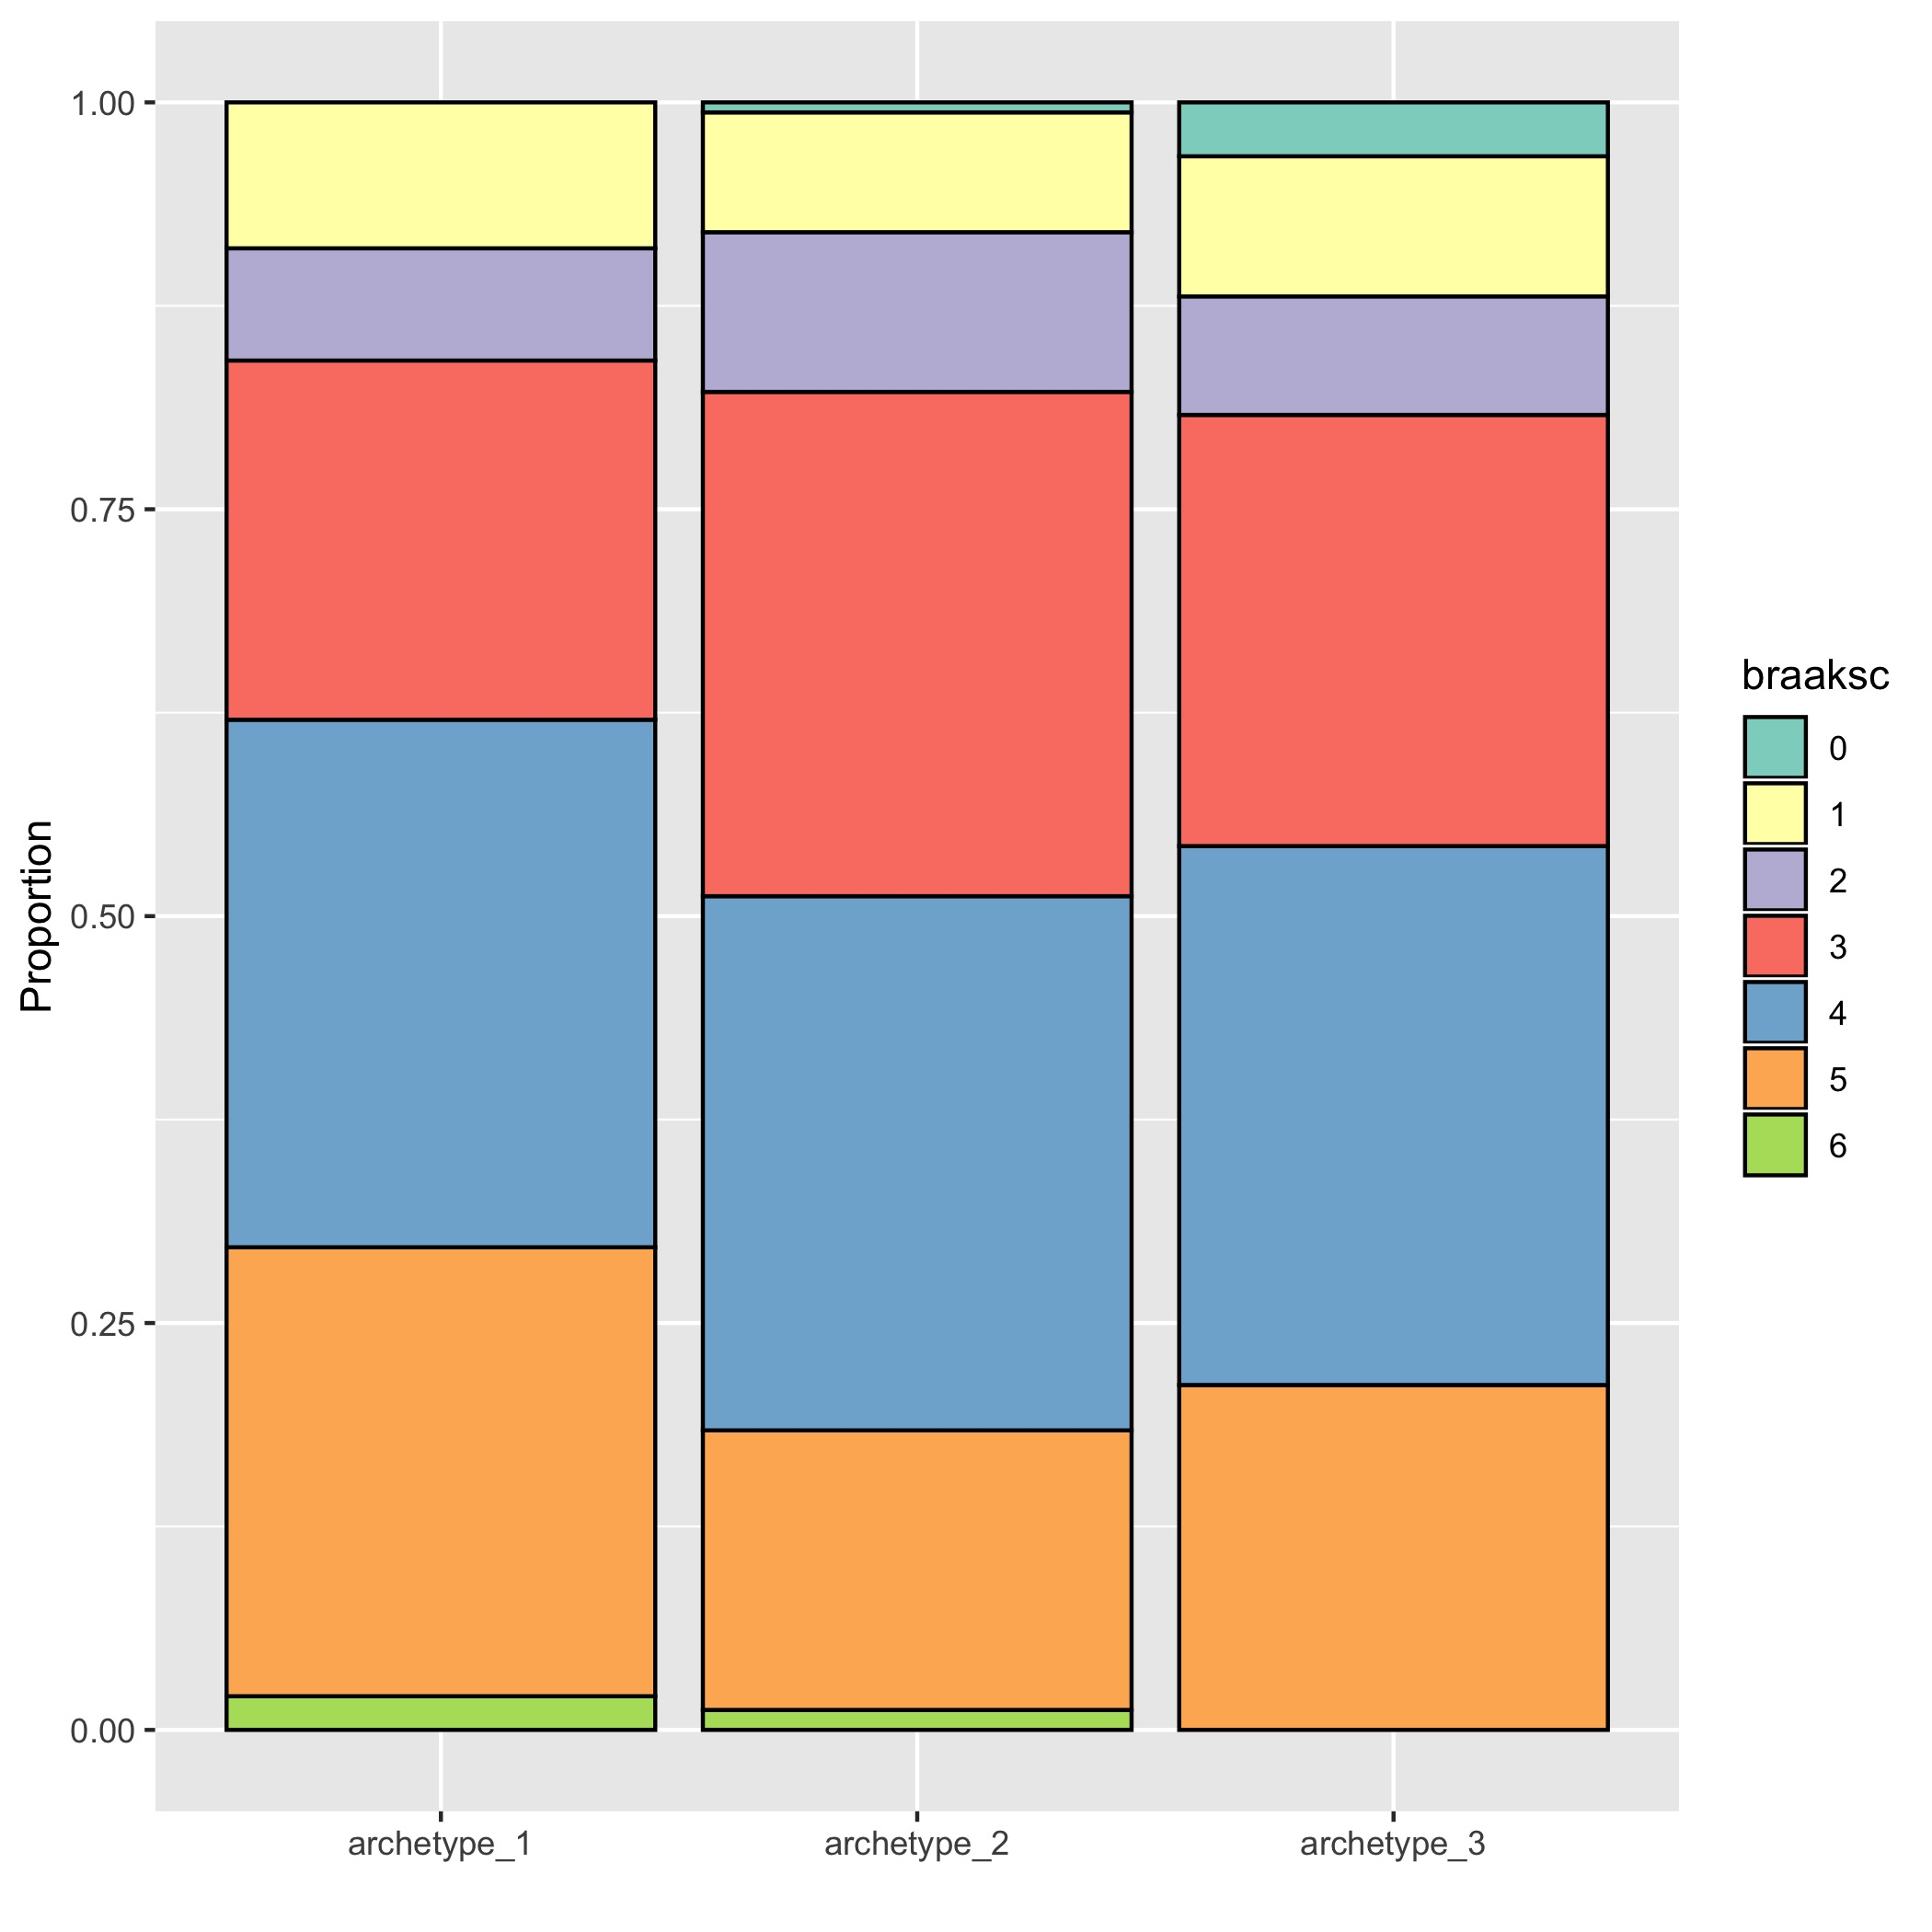
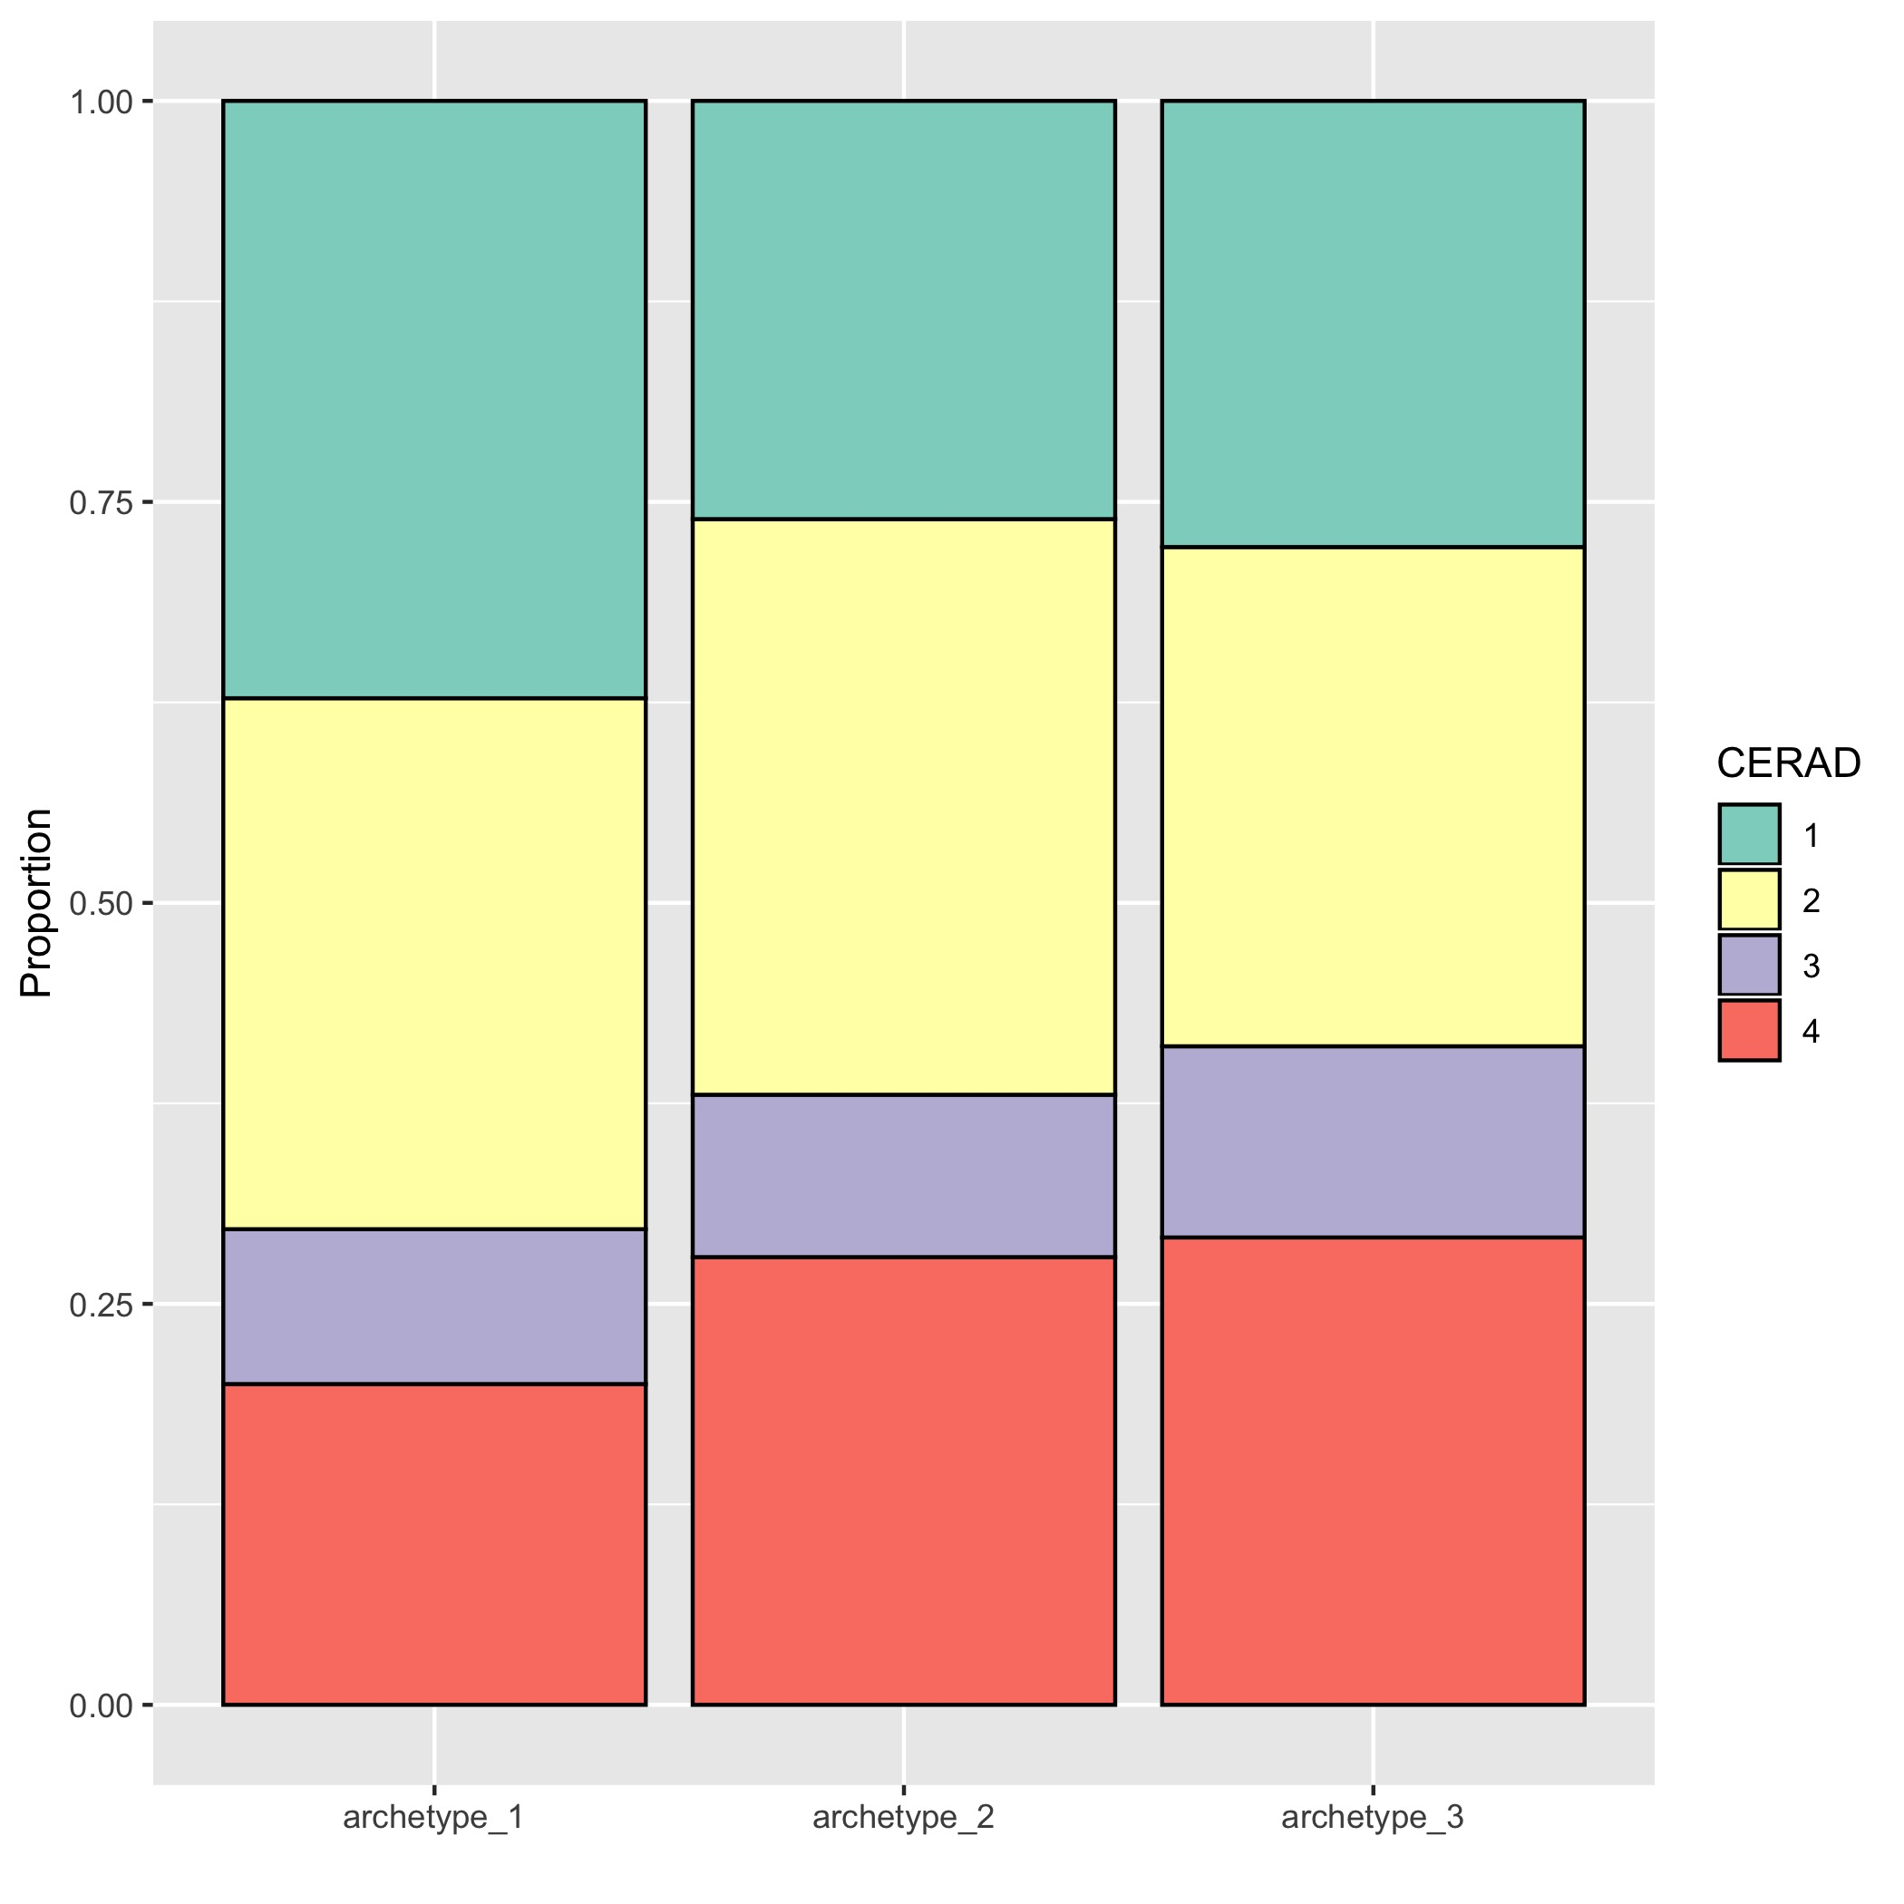
Diagnosis at time of death: Archetype 1 is slightly enriched for AD patients
Cognitive score
Braak
CERAD
------ Control -------
--------- AD -----------
--------- MCI -----------
--------- AD -----------
------ Control -------
--------- AD -----------

Slide 39
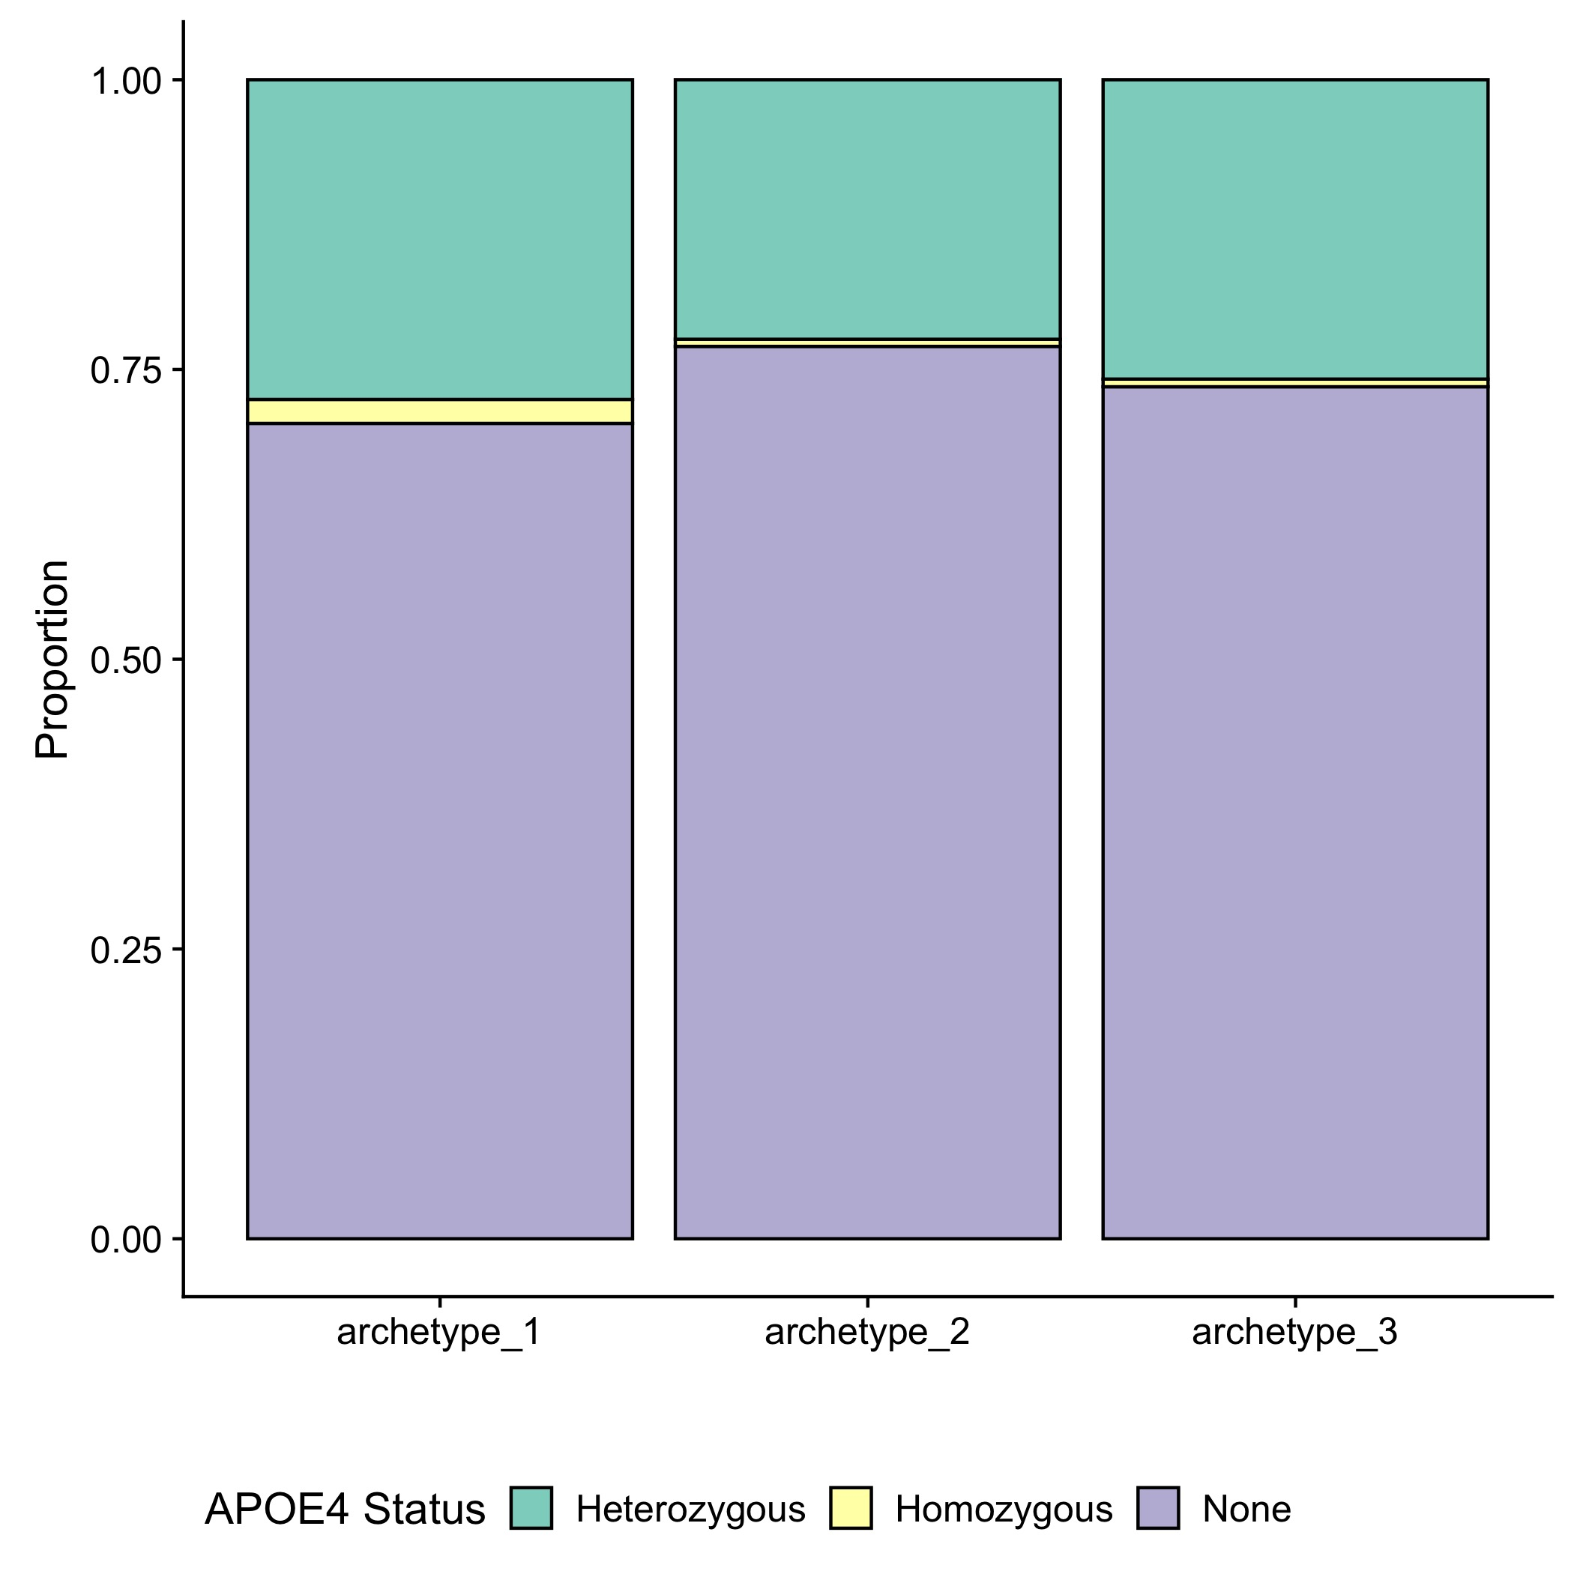
APOE4 status for all samples:
Archetype 1 includes slightly more heterozygotes and homozygotes
Notes:
All samples

Slide 40
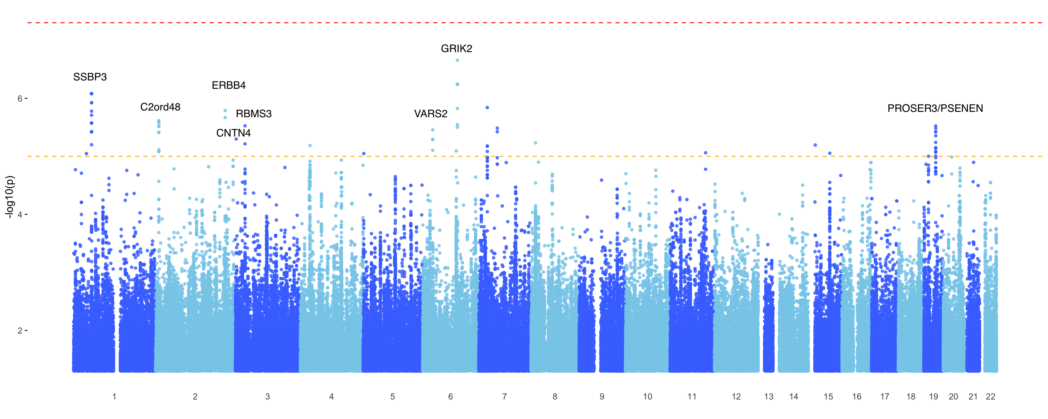
GWAS (EMMAX) of distance from each archetype for all samples
Archetype_1
Notes:
Nothing is significant at the 1^-8 level but plenty are suggestive

Slide 41
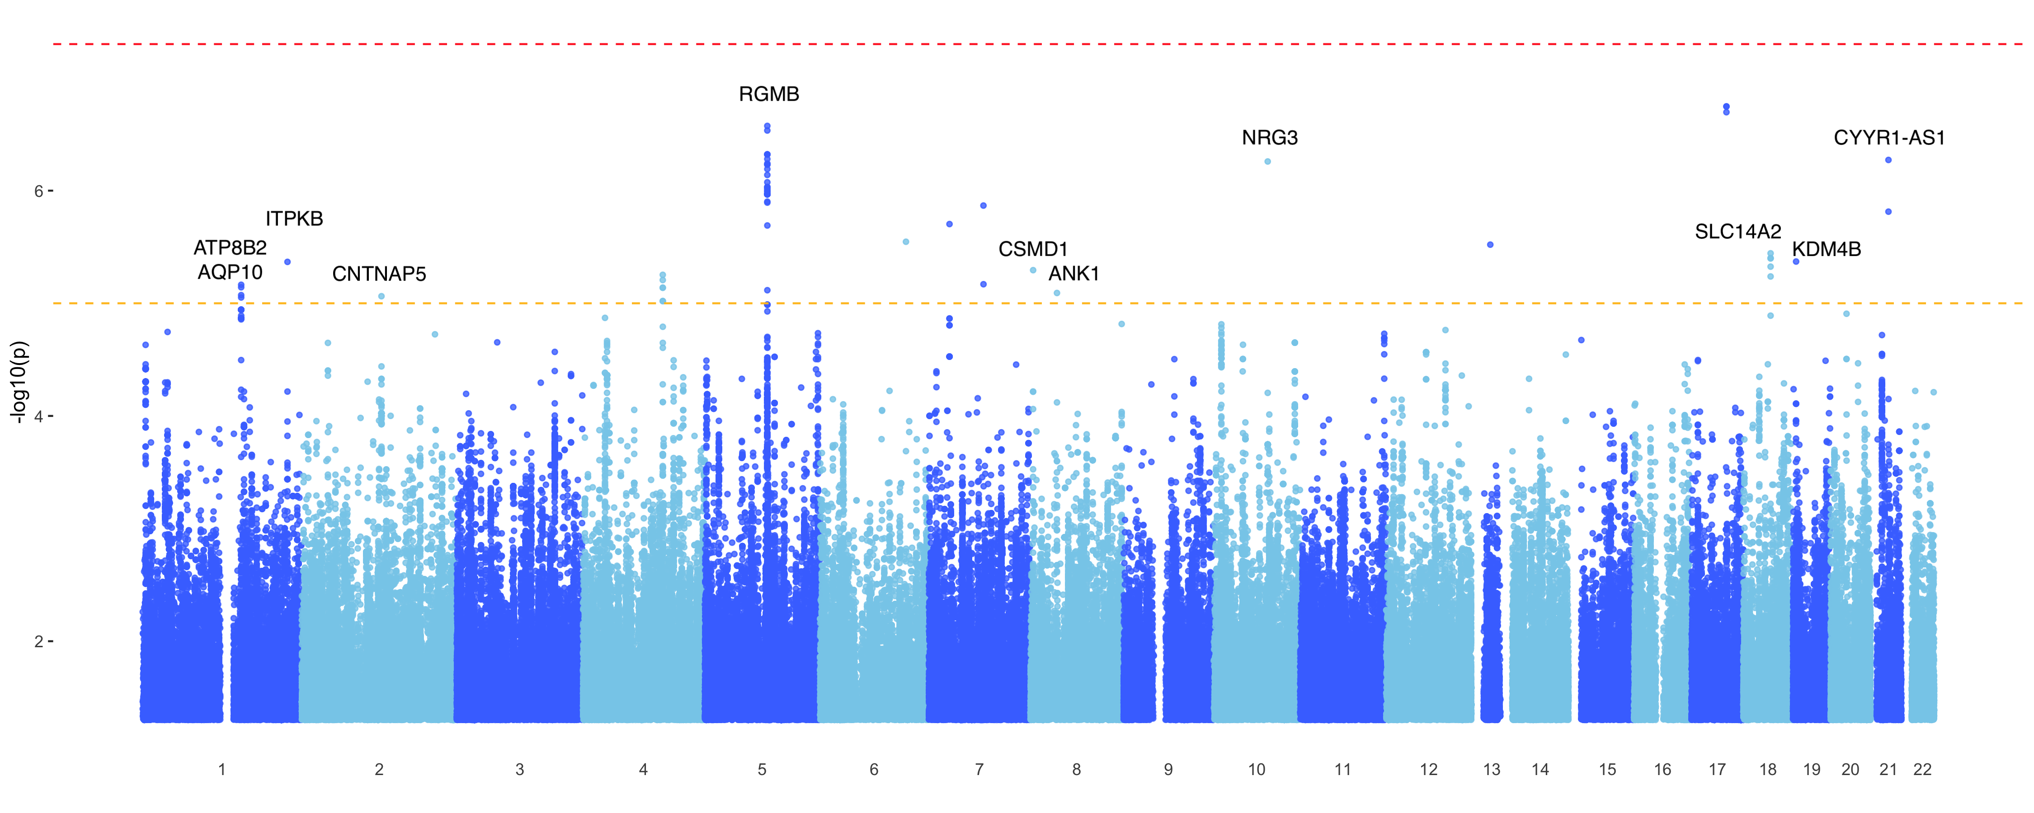
GWAS (EMMAX) of distance from each archetype for all samples
Archetype_2

Slide 42
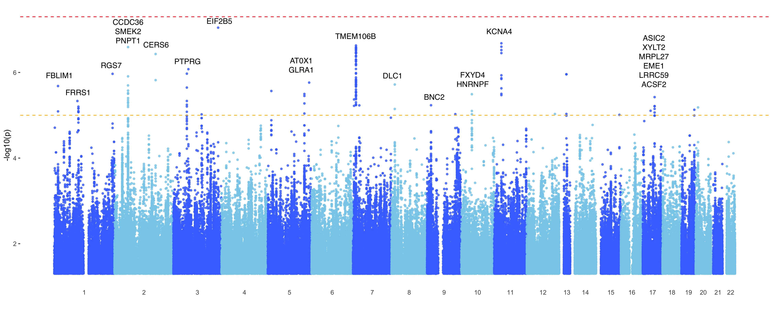
GWAS (EMMAX) of distance from each archetype for all samples
Archetype_3

Slide 43
Overlap of mapped genes between different phenotypes
Notes:
Adding submodules to the picture:
For clarity I removed the genes that are not shared with at least one of the other phenotypes.
As Nikhil already found in his work, the submodules are all over the place, overlapping with archetypes and subtypes that are otherwise unassociated, but not much with clinical phenotypes.
Yellow_1 overlaps a lot with archetype_3, which is in accord with the gene expression data. same for brown_1 and yellow_2 overlapping with archetype 2, but otherwise it's not really in accord with the gene expression profiles.
Interestingly, archetype 3 overlaps with the submodules more than subtype B even though subtype B was more directly derived from the submodules. Particularly, it reveals 3 new genes that are joined between archetype 3 and two or more submodules:
CERS6: phospholipid activity; neuronal TM signal transduction; PD
PNPT1: oxidative phosphorylation; mtRNA metabolism
PTPRG: protein dephosphorylation; TM signal transduction; neuronal development; cellular processes (PTPN5)
https://www.ncbi.nlm.nih.gov/pubmed/28527217
In addition, KCNA4 and TMEM106B are even more of a hub when the submodules are included.
CNTNAP5: neurexin family; neuronal cell adhesion and intercellular communication; epidermal growth factor; in accord with the other genes associated with archetype_2

Slide 44
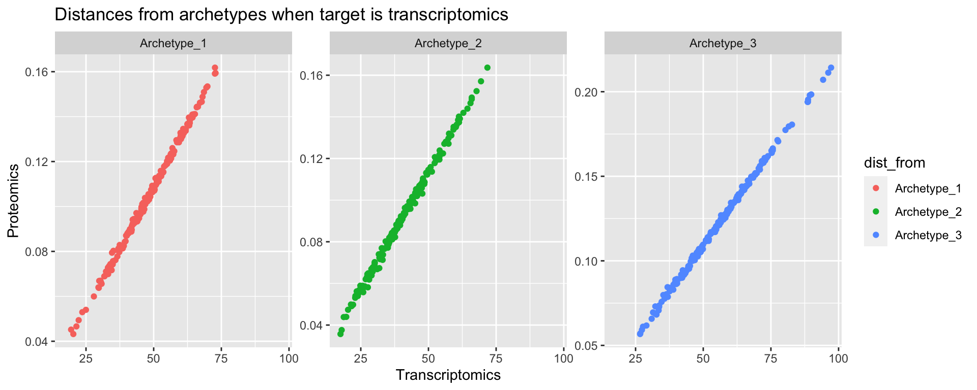
Distances from archetypes in the GE space compared to transcriptomics space

